Slide 1
Cloud Architectures
for Big Data

Slide 2
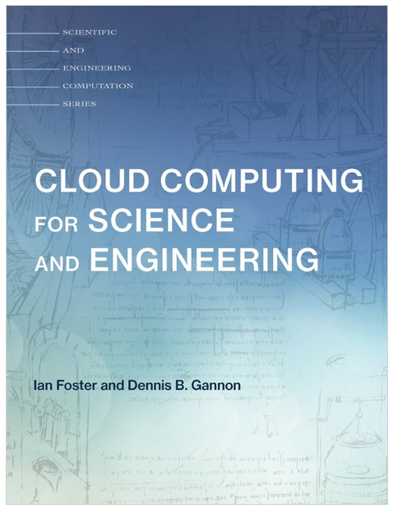
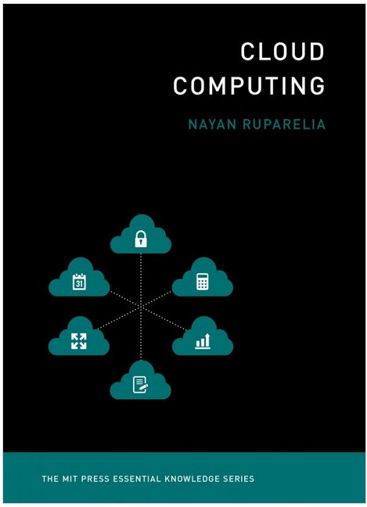
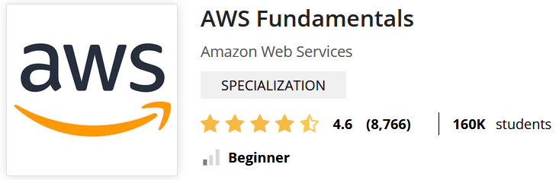
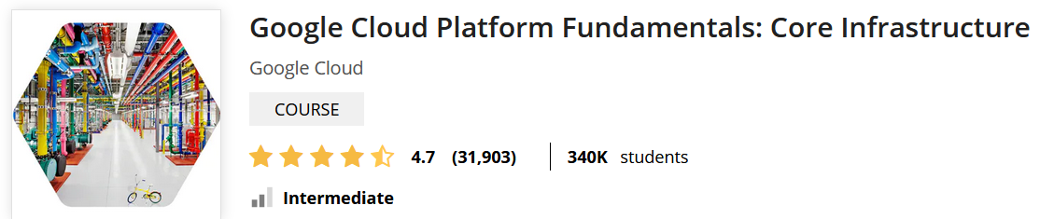

Material
Web sources
https://www.coursera.org/learn/aws-fundamentals-going-cloud-native
https://www.coursera.org/learn/gcp-fundamentals
https://engineering.fb.com/
https://docs.cloudera.com/runtime/7.2.0/scaling-namespaces/topics/hdfs-ec-understanding-erasure-coding-policies.html
https://mitpress.mit.edu/books/cloud-computing-science-and-engineering
https://mitpress.mit.edu/books/cloud-computing

Slide 3
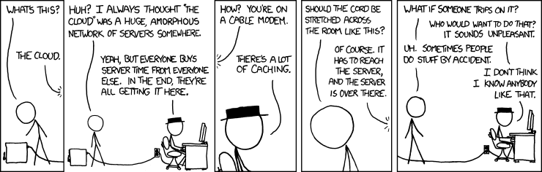
Cloud computing
https://xkcd.com/908/

Slide 4
Cloud computing
National Institute of Standards and Technology (NIST)
Cloud computing is a model for enabling ubiquitous, convenient, on-demand network access to a shared pool of configurable computing resources (e.g., networks, servers, storage, services) that can be rapidly provisioned and released with minimal management effort or service provider interaction. Cloud model promotes availability and is composed of five characteristics
On-demand self-service (consume services when you want)
Broad network access (consume services from anywhere)
Resource pooling (infrastructure, virtual platforms, and applications)
Having big pools of resources enables economy of scale
Rapid elasticity (enable horizontal scalability)
Measured service (pay for the service you consume as you consume)
Why going cloud?
Cloud enables agility (at high speed) that is not possible on premises
Is it just a substitute for on-premises?
Engineering perspective: cloud eliminates repetitive IT tasks to focus on what is strategically unique
Data scientist perspective: cloud abstracts architecture and offers integrated services

Slide 5
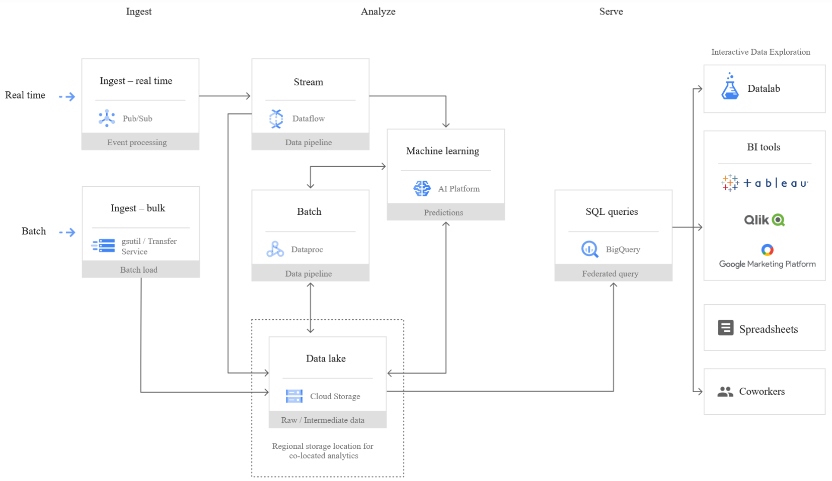
Roadmap proposal (10h)
Which are the services offered on cloud vs on premises?
TODO: Survey of existing services (Google + Amazon)
TODO: Insights on some services (e.g., google file system, big query, big table)
Look for something non similar to what is in Module 1 (e.g., no HDFS vs GFS architecture if similar)
Engineering perspective: cloud eliminates repetitive IT tasks to focus on what is strategic
Which are the differences in setting up wrt on-premises?
Given a pipeline (e.g., watering case study)
Understand which services are needed
Ingestion
Storage
Computing
ML (?)
On prem
Configure them on bare linux with docker
Configure them with cloudera
On cloud configuration
WEB API
Ingestion (stream)
Analysis
(2)
(1)
(3)
Storage
Query
(4)

Slide 6
Roadmap proposal (10h)
Data scientist perspective: cloud abstracts architecture and offers integrated services
Which are the differences in usage wrt on-premises?
Data pipeline experiments
Integration with analytic/ML libraries
IMHO, una volta che è stato creato un ambiente integrato, le pipeline saranno simili
La differenza sta nella scalabilità/elasticità (capire come mostrarle)
Seminario (3h)
Real case study with real pricing
I tool di pricing sono disponibili, ma è difficile stimare senza avere workload effettivo. Potremmo stimarne uno sulla base di watering, ma averne uno in ottica aziendale sarebbe bello/significativo

Slide 7

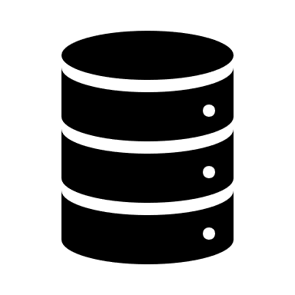


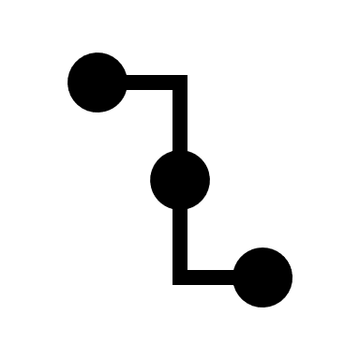
Data science
Data pipeline:
transform data to wisdom
Architecture:
support data pipelines
Serve (deciding)
SQL
BI tools (e.g., Tableau)
Storage (organizing)
File
Object
DB
Security
Access Control
Authorization
Wisdom
(applied knowledge)
Analytics (analyzing)
Processing
Batch
Streaming
Machine learning
Knowledge
(organized information)
Data pipeline
Information (linked elements)
Data (abstracted elements)
Ingestion (acquiring)
Batch
Streaming
World
Computing + Networking

Slide 8
Service | Google Cloud Platform | Amazon AWS | On-premises
Computing & Virtualization | Docker + Kubernetes | Docker through Elastic Container Service ECS Kubernetes EKS AWS Lambda | ??
Networking | ?? | Virtual private cloud VPC | ??
Storage | File System GFS (Colossus) Database Relational: Cloud SQL Spanner NoSQL: Cloud Datastore Bigtable Object storage Cloud storage | File System Elastic File System (EFS) Elastic Block Store (EBS) Database Relational: Relational Data Service (RDS) Aurora NoSQL: DynamoDB HBase Object storage S3 | File System HDFS Database Relational: Hive NoSQL: Hbase Object storage ??
Ingestion | Batch ?? Streaming ?? | Batch ?? Streaming ?? | Batch ?? Streaming ??
Processing | Batch ?? Streaming ?? | Batch ?? Streaming ?? | Batch Spark Streaming ??
Machine learning | ?? | ?? | Spark ML
Serving | SQL Big query | SQL Athena | SQL Spark SQL

Slide 9
Cloud computing: history in brief
The idea of computing as a service is far from new
Artificial intelligence pioneer Professor John McCarthy, speaking at MIT’s centennial celebration in 1961,
“Computing may someday be organized as a public utility just as the telephone system is a public utility. […] Each subscriber needs to pay only for the capacity he uses, but he has access to all programming languages characteristic of a very large system … The computer utility could become the basis of a new and important industry.”
1969 UCLA turned on the first node of ARPANET, Internet pioneer Leonard Kleinrock claimed that “as [computer networks] grow up and become more sophisticated, “computer utilities” will spread
1990s US, gigabit testbeds linked research laboratories. Researchers started to talk about meta-computers [237] — virtual computational systems created by linking components at different sites.
Physicists designing Large Hadron Collider (LHC) needed to federate computing systems at hundreds of sites to analyze petabytes of data. Developed LHC Computing Grid (LCG) [175], which enabled on-demand access to computing, storage, and other services [127]
2006 Emergence of cloud computing, a story of marketing, business model, and technological innovation
Cloud is driven by a transformation in demand (First successful IaaS emerged from an e-commerce provider)
Amazon was building hundreds of similar work-unit computing systems to support different services

Slide 10
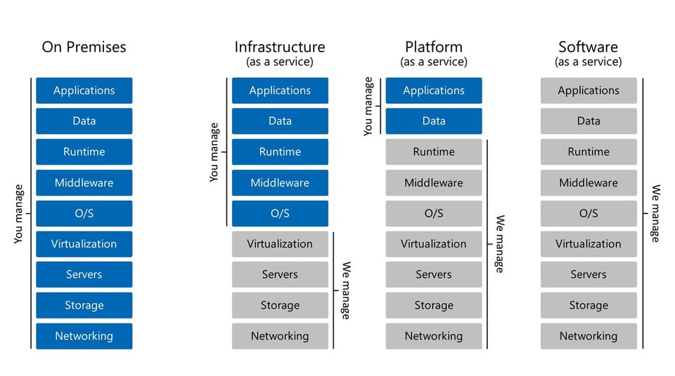
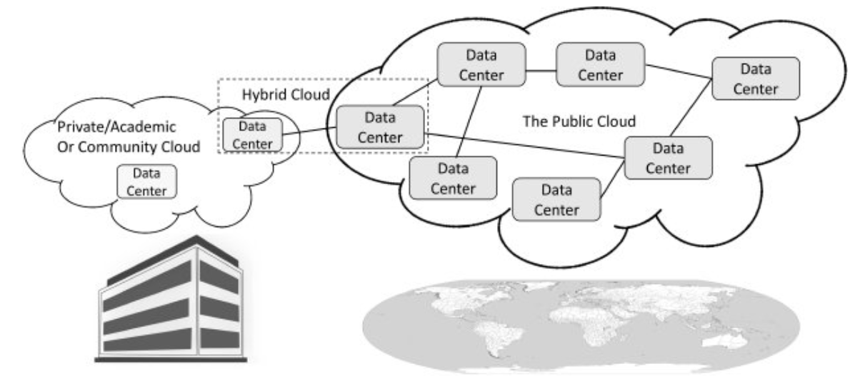
Cloud computing
Cloud deployments
Infrastructure as a Service, IaaS
Raw compute, storage, network
Pay for what you allocate
Platform as a Service, PaaS
Focus on your application logic
Use libraries that give access to infrastructure
Pay for what you use
Types of cloud
Public clouds are accessible to anyone willing to pay (e.g., Microsoft, AWS, Google)
Private clouds are accessible by individuals within an institution
Hybrid clouds: a mix of the previous
Interfacing with cloud services
Portals
REST APIs

Slide 11


Vertically
Scaling
Horizontally
(scaling up)
Keep same resources but more capable
Add memory, storage, or compute power
Do not have to distribute
Downtime when vertically scaling
Do not scale back down
(scaling out)
Add resources, distribute across them
No downtime for original resource
As load grows, add more resources
If need less resources, scale back
https://www.coursera.org/learn/aws-fundamentals-cloud-migration/lecture/4sO8t/scaling-considerations

Slide 12
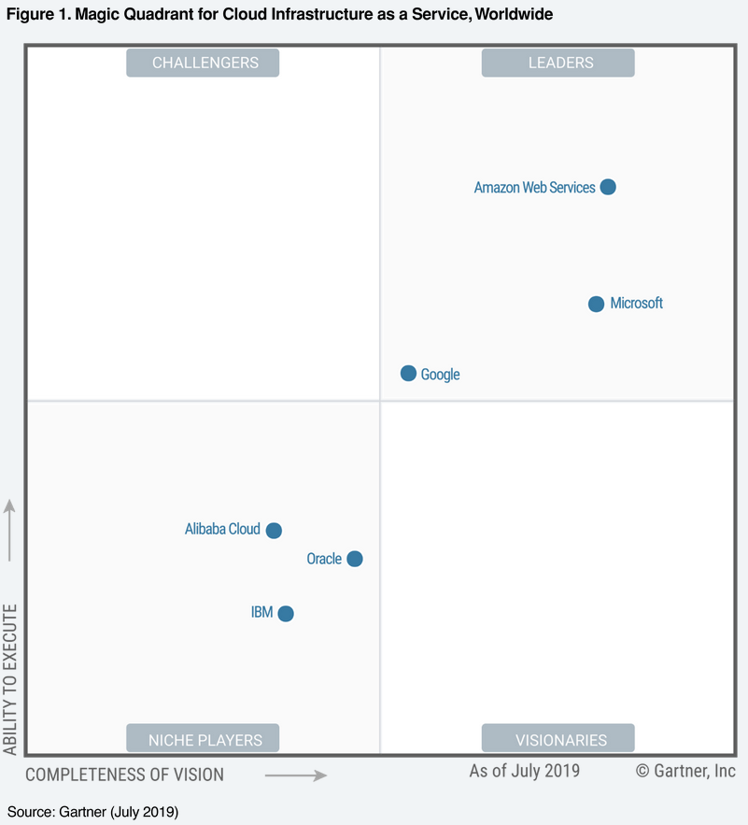
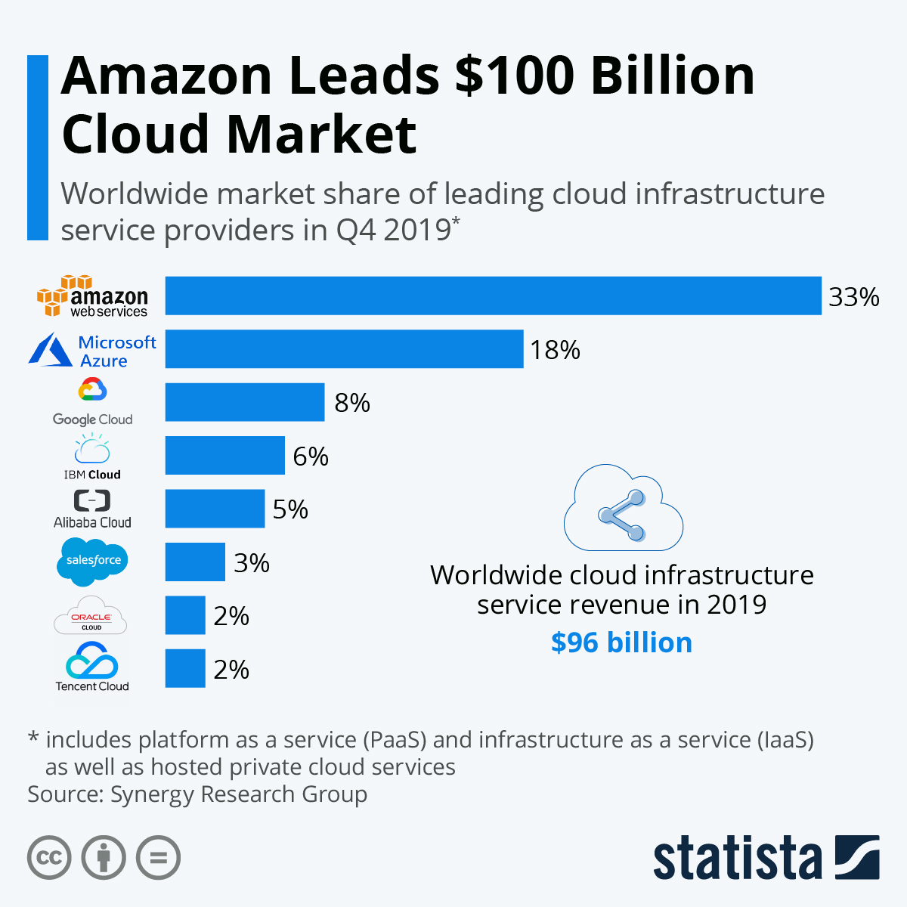
Cloud computing
Chi ci da accesso ai Lab/Crediti
Non tanto per il lab, quanto anche per tesi
https://www.statista.com/chart/18819/worldwide-market-share-of-leading-cloud-infrastructure-service-providers/
https://aws.amazon.com/about-aws/global-infrastructure/

Slide 13
Cloud computing and big data
Unbounded scalability of storage, infrastructure, platform led to farming of data
Hype and strengthen big data opportunities
Datasets are
From various sources and unstructured (variety)
Of large size (volume)
With fast data in/out (velocity)
Architecting the cloud for big data led to new architectures
Challenges: data assimilation, aggregation, classification, etc.
Deploying a cloud requires to
Standardize service offerings
Make them available through simple portals
Track usage and cost information with billing mechanism
Measure availability
Orchestrate to meet demand
Provide a security framework

Slide 14
IOT

Slide 15
Data pipeline: Google Cloud
https://cloud.google.com/storage/

Slide 16
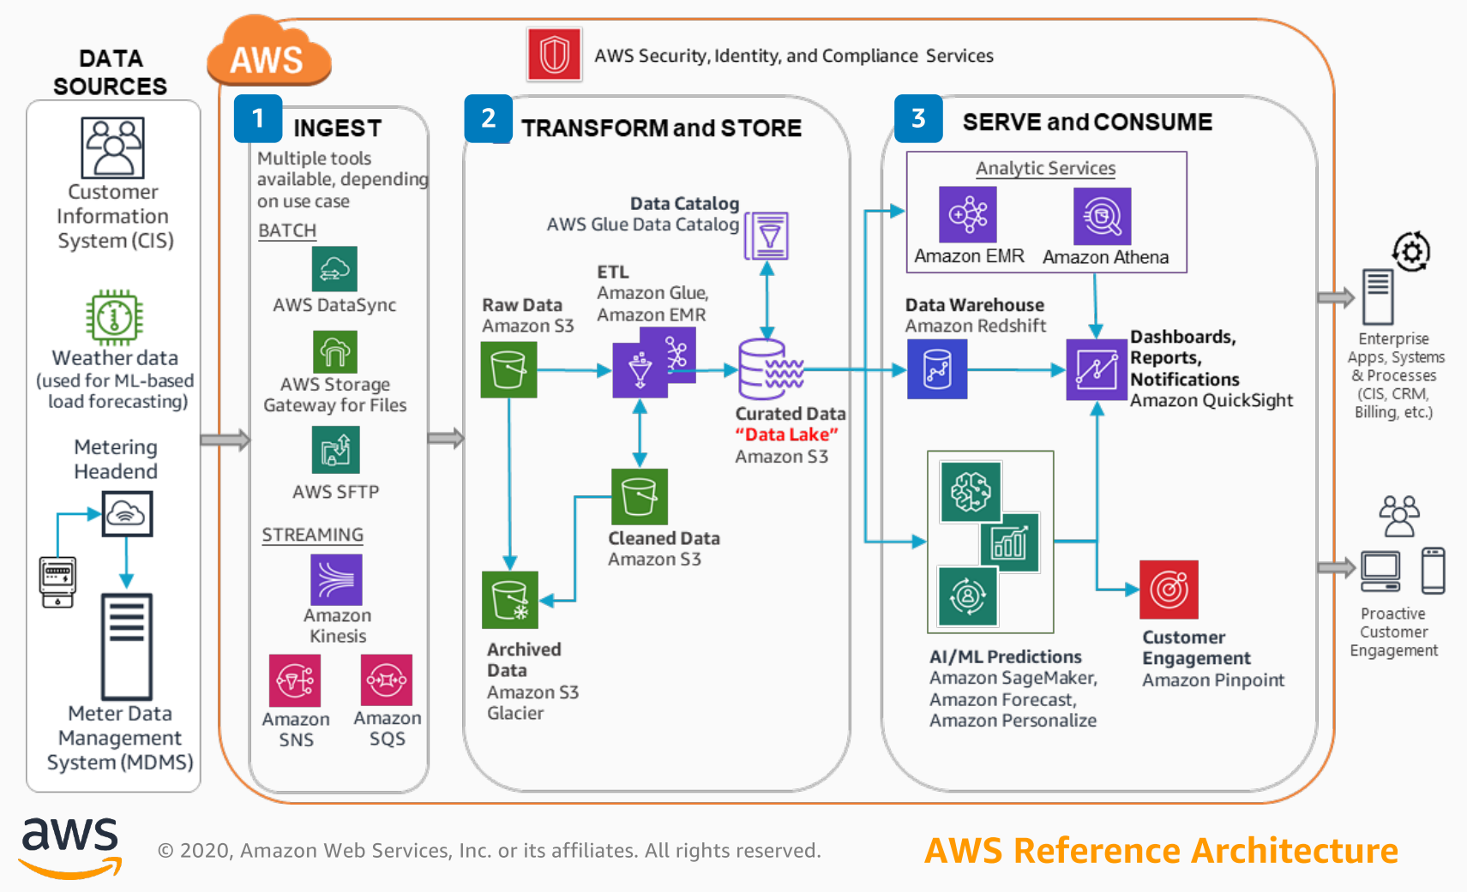
Data pipeline: Amazon

Slide 17

Regions
Region is a geographically self-contained area where all resources are located
Which Region is the right Region for business?
Latency
Price, each country has own set of tax laws and financial situations
Legal compliance, e.g., specific United States HIPAA / European GDPR requirements
Region is inside a single country boundary bounded by a single set of laws
Service availability
AWS: a region is a collection of availability zones
AZ as a standalone data center (while it might be 2/3 buildings spread across a parking lot)
Region contains at least 2 AZ separated by (tens) miles, connected with high-speed fiber network
Ensure Scalability + Availability
Resources aren't replicated across AWS Regions unless explicitly specified
Google Cloud: a region is a collection of zones
Zones have high-bandwidth, low-latency network connections to other zones in same region
Google recommends deploying applications across multiple zones and multiple regions

Slide 18
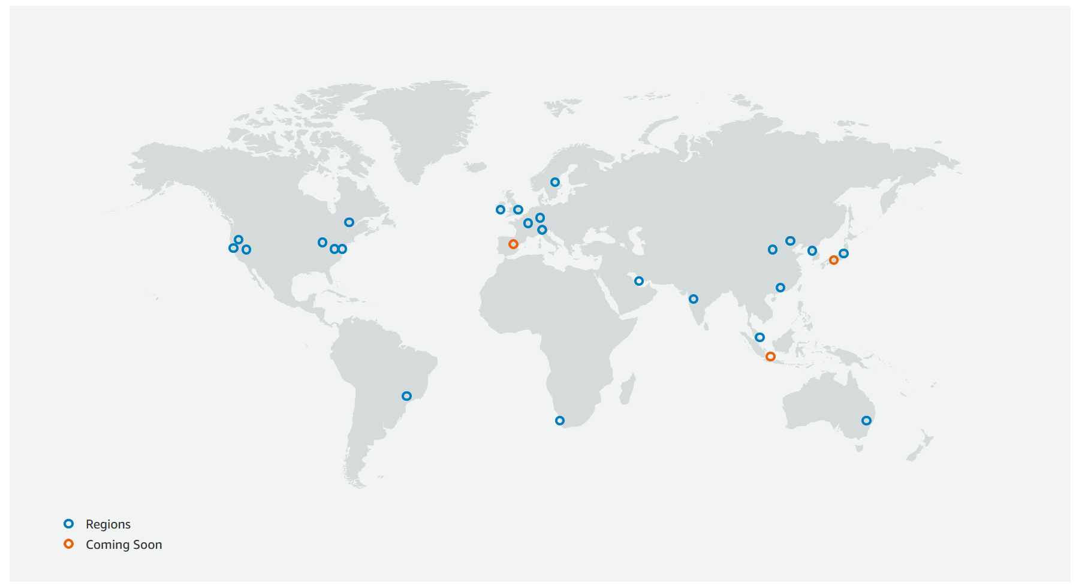
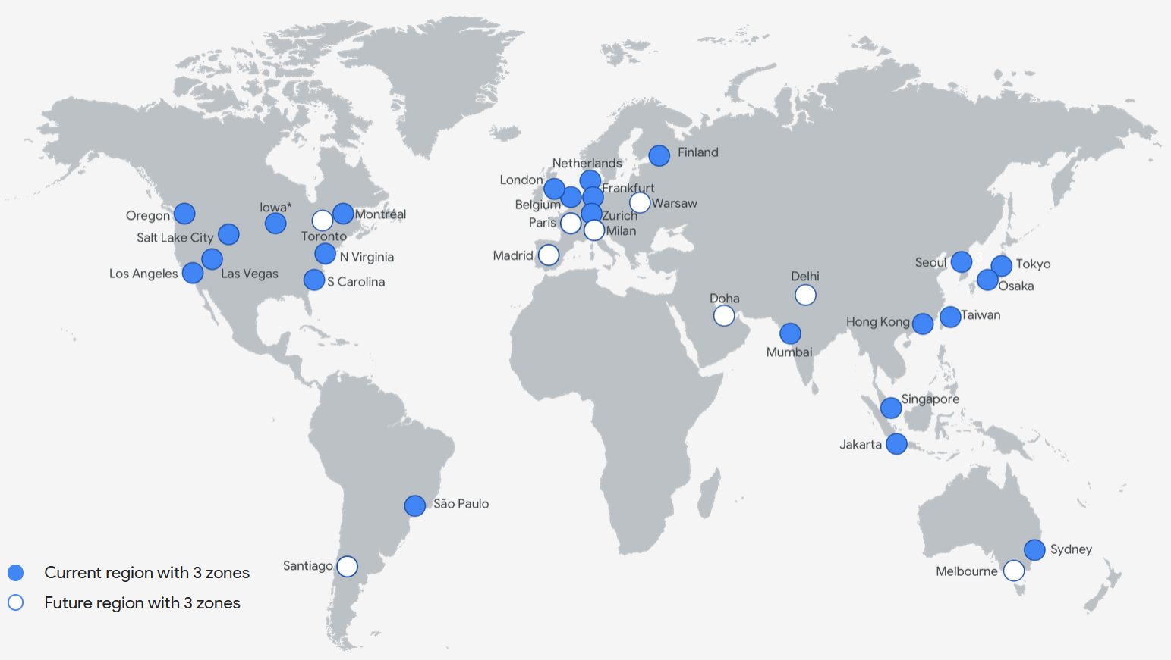
Regions
https://aws.amazon.com/about-aws/global-infrastructure/
https://cloud.google.com/about/locations

Slide 19
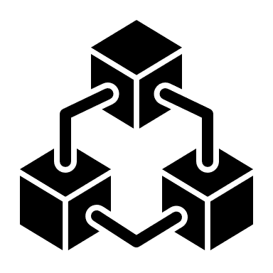
Compute
In a traditional environment
Estimate how much compute capacity you're going to need
Buy necessary hardware to support that capacity
Set up computers / servers to run applications
After deploy, maintain from hardware/software perspectives
In contrast, when you're building cloud-native applications
Compute as a service model, if resources are under(over)previosioned, (down)scale, no HW maintenance
AWS offers managed compute options
Amazon Lightsail offers compute capacity without worrying underlying hardware (e.g., LAMP stack)
Container services that allow you to use Docker through Elastic Container Service
Kubernetes through EKS
Pure serverless solutions, like AWS Lambda

Slide 20
Compute: Amazon EC2
Amazon Elastic Compute Cloud (EC2)
Compute service that provisions virtual servers on demand
Each virtual server is called an EC2 instance
You can commission one/many instances easily, and you only pay for what you use
When you no longer need an instance, terminate or stop that instance, and you will stop incurring charges.
Just about anything you can do with a server in a traditional sense, you can do with an EC2 instance
EC2 instances are flexible, and you configure them to meet your needs
Choose operating systems (e.g., Linux, Ubuntu, Windows) through an Amazon Machine Image AMI
Plus possible applications to be installed on that instance
Plus amount of compute, memory, and networking capabilities available per instance
Different types of hardware depending on use case
E.g., G instance type is optimized for graphics-intensive applications (3D visualizations or video encoding)

Slide 21
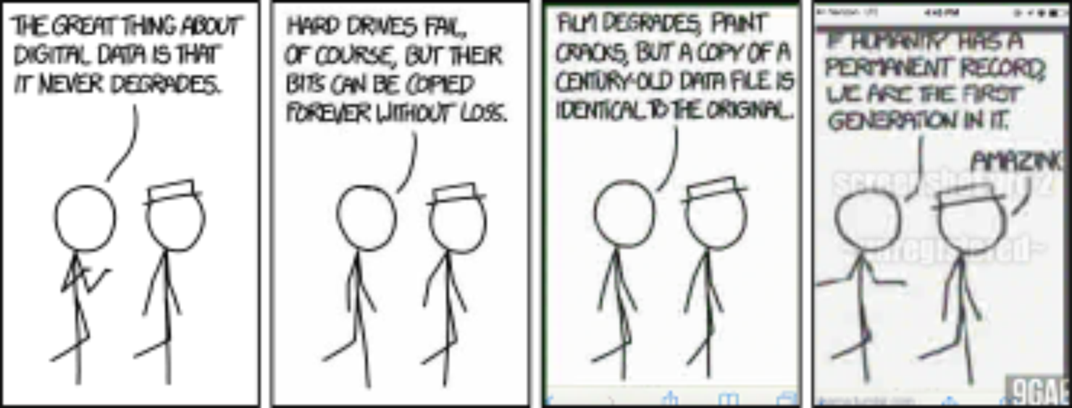
Storage
https://xkcd.com/1683/

Slide 22
Storage
Storage models
Different ways in which data are organized in a storage system
Cloud storage systems support a wide range of highly scalable models
File systems (or file storage)
Object storage
Block storage
Relational / NoSQL / Graph databases
Understand properties of these different storage models to choose the right system.
The right model depend on nature and size of the data
Analyses to be performed
Access / Update frequencies

Slide 23
Storage: file system (or file storage)
File systems (FS; or file storage)
Tree of directories, represent hierarchical relationships among data
Standard API for Unix version of FS is Portable Operating System Interface (POSIX)
create, read, write, and delete files located within directories
HDFS is not a POSIX file system: it is write-once, read-many, and eventually consistent
Command line tools make it usable similarly to Unix FS
FS are fine for day-to-day usage on personal computers, and medium to large enterprises
File storage is commonly seen and deployed on hard drives and Network Attached Storage (NAS) systems
FS model has disadvantages as data volumes grow
Files stored in FS have limited metadata (creation date, modification date, and file size)
Performance can go down because of the increasing resource demands on the filesystem to keep
Data modeling: no support for conventions on representation of data elements and relationships
Environmental data in NetCDF files, genomes in FASTA files, and observations in comma-separated-value (CSV)
Hierarchical organization does not always match actual relationships
Cannot navigate complex data collections
Scalability perspective: maintaining consistency as multiple processes read/write lead to bottlenecks

Slide 24
Storage: object storage
Object storage (OS)
OS simplifies the FS
As FS, store unstructured binary large object (blob)
Two-level folder-file hierarchy with containers, each of which can hold zero or more objects
Object identified by unique identifier
Can have various metadata associated with it
Objects cannot be modified once created
In OS supporting versioning, object can be replaced
Any individual who possesses identifier can access data
Advantages in terms of simplicity, performance, and reliability
Static objects make it easy to build highly scalable implementations
Object can be replicated across multiple storage devices to increase resilience and performance, without any specialized synchronization logic (no concurrent updates)
Objects can be moved among storage classes with different performance and costs
Limitations
Little support for organizing data and no support for search
Does not provide any mechanism for working with structured data
Cannot easily be mounted as a FS or accessed with existing tools in the ways that a FS can

Slide 25
Storage: block storage
Block storage
OS and FS treat files as a single units
Block storage treats data as a sequence of fixed-size “blocks” s.t. each file could be spread in blocks.
Blocks are not be stored contiguously
When data is requested, storage system merges the data blocks back together
Each block has a different and unique address and exists independently of all others
Can retrieve data very quickly because there is not necessarily one path to the data (e.g., a disk array in which data for the same file can be read from multiple disks)
Block storage also achieves high efficiency because blocks can be stored wherever it is most convenient
Usually expensive and has limited capability to handle metadata
Block storage is commonly deployed in Storage Area Network (SAN) storage
Can think of block storage as the foundation on which file storage systems are built

Slide 26
Storage: database
Database (DB) is a structured collection of data about entities and relationships
Database management system (DBMS) manages databases and provides three components
Data model (which defines how data are represented),
Query language (which defines how the user interacts with the data)
Transactions and crash recovery (to ensure reliable execution despite system failures).
DBMSs support a variety of data formats
Relational: efficient storage, organization, and analysis of large quantities of tabular data
Structured Query Language (SQL) to specify a wide range of operations on tables
Relational algebra provides a clear, mathematical meaning to SQL
ACID:
Atomicity (the entire transaction succeeds or fails),
Consistency (the data collection is never left in an invalid or conflicting state),
Isolation (concurrent transactions cannot interfere with each other)
Durability (once a transaction completes, system failures cannot invalidate the result).
NoSQL: storage of (large) unstructured data
Scale the quantities of data and number of users that can be supported
Key-value store associates key with an arbitrary value, document store permits text search on stored values
Do not support the full relational algebra
Can be distributed over multiple servers and replicated over different data centers
No ACID properties. Eventual consistency: database state may be momentarily inconsistent across replicas
CAP (Challenges of scale) An obvious solution to scaling databases is to distribute and/or replicate data
Distribution and replication also introduce challenges
Consistency indicates that all computers see the same data at the same time.
Availability indicates that every request receives a response about whether it succeeded or failed.
Partition tolerance indicates that the system continues to operate even if a network failure prevents computers from communicating.
CAP Theorem observes that it is not possible to create a distributed system with all three properties
The right combination of availability and consistency will depend on the needs of the service

Slide 27
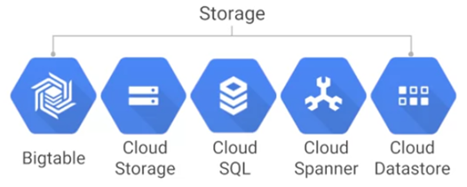
Storage: cloud landscape
Model | Amazon | Google
Files | Elastic File System (EFS) Elastic Block Store (EBS) | Google Cloud attached file system
Objects | Simple Storage Service (S3) | Cloud Storage
Relational | Relational Data Service (RDS) Aurora | Cloud SQL Spanner
NoSQL | DynamoDB HBase | Cloud Datastore Bigtable
Warehouse analytics | Redshift | BigQuery

Slide 28
Storage: Amazon
Amazon Secure Simple Storage (S3), object storage
Objects are stored in buckets, repositories that live in a specific Region
Bucket names need to be globally unique across all AWS accounts and must be DNS-compliant
Objects are accessible over HTTP or HTTPS
If you have an image and you want to update it, you update the entire file
S3 offers 99.99% availability with 11 nines of durability
Store three copies of your data redundantly across AWS facilities within the Region that you selected
Often used as a place to comfortably store backups (e.g., EBS snapshots)
By default, when you upload an object into a bucket, it is private
Control bucket and object access through access control lists, and bucket policies
Write, read, and delete objects up to 5TB
Bucket is not limited, which allows for uncapped storage growth

Slide 29
Storage: Amazon
Amazon Elastic Block Storage (EBS)
Persistent block storage volumes for use with Amazon EC2 instances in the AWS Cloud
Each EBS volume is automatically replicated inside an Availability Zone to protect from failure
Optimize storage performance and cost for your workload
SSD-backed storage for transactional workloads, such as databases and boot (performance depends on IOPS)
HDD-backed storage for throughput-intensive workloads, such as MapReduce (performance depends on MB/s)
Pricing is based on the amount (volume) and type of Amazon EBS volume that you provision
EBS volumes have a lifecycle independent of EC2
EBS volumes behave like raw, unformatted block devices that you can mount to instances
Amazon Elastic File System (EFS)
Simple, scalable, elastic file storage for use with AWS Cloud services and on-premises resources
Massively parallel shared access to thousands of Amazon EC2 instances
Standard file system interface
Multiple Amazon EC2 instances can access an Amazon EFS file system at the same time
Using File Sync, connect EFS to your on-premises data center
EFS is a shared file (storage) system that uses NSFv4and
EFS important while running multi environment workloads
https://calculator.s3.amazonaws.com/index.html

Slide 30
Storage: Amazon
Amazon Relational Database Service (RDS)
Run a relational database of the flavor of your choosing
Runs on block-level storage, to change the location for a contact, just change the corresponding blocks
AWS takes care of high availability, backups, or scaling.
Relational databases allow for medium to high amount of throughput and require rigid schemas
Define how much capacity you need in terms of memory and CPU
Amazon DynamoDB
NoSQL database
Fully managed, do not have to manage any of the underlying infrastructure running that database
Simply create a table, define your throughput needs, and you can start populating it with your data
No limit on table size, which means you can store any amount of data
DynamoDB synchronously replicates your data across three facilities in an AWS Region
Supports both document and key-value store models.

Slide 31
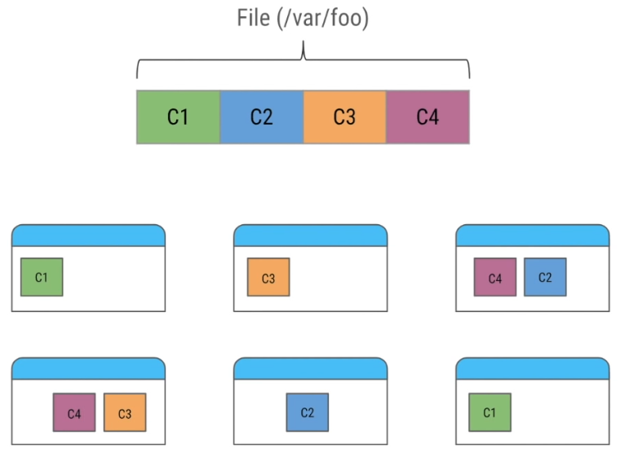
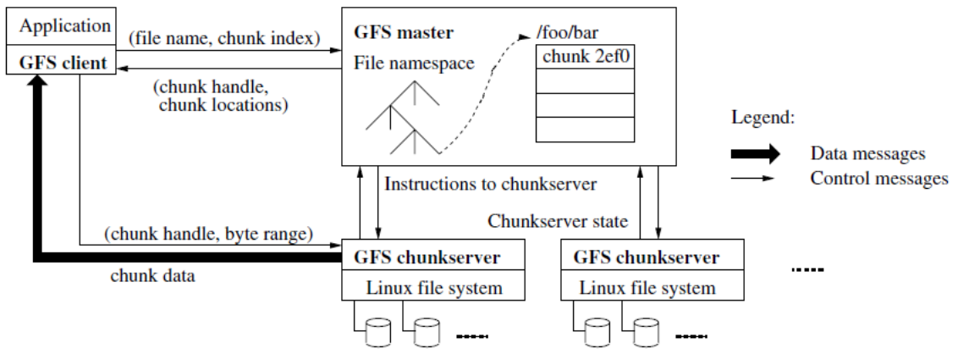
Storage: Google File System (GFS)
Basic considerations which forced Google to switch to a new file system
Fault tolerance (commodity hardware)
Error detection and automatic recovery
GFS (2003), distributed file storage built on commodity hardware
Optimized for read / append operations
Files are divided into fixed size chunks (64MB), works well with big files
Each chunk is replicated (not the entire file) on multiple servers (3 by default)
Master-server relationship
Master (one for ~thousands of clients)
A global unique 64bit pointer is used to handle each chunk
Maintains all metadata
File and chunk namespaces (mapping from files to chunks)
Access control
Location of each chunk’s replica
Responsible for chunk management/migration between chunkservers
Garbage collection mechanism to avoid fragmentation
Client asks which chunkserver to contact using file name and byte offset
Minimum interaction client/master

Slide 32
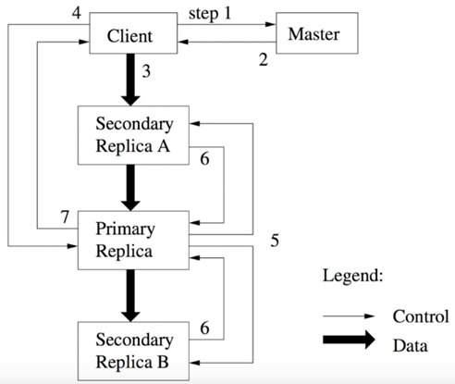
Storage: Google File System (GFS)
Writing new data
Ask for available locations
Write data to the closest replica
Data are the propagated through replicas
Initially, data are now written directly to disk
Request commit to primary replica
Primary instructs writing to secondaries
Secondaries acknowledge
Primary ack to the client
Master is a single point of failure
Operations (with timestamp) are written in a log in background
Log is replicated
When master reboots, it replays the log
Operations are periodically checkpointed, so that master does not start from scratch
In any case, a shadow master is set up
In case of crash, DNS redirect to shadow master (might cause some lag)

Slide 33
Storage: Google File System (GFS)
GFS (2003) does not provide a POSIX interface, but a proprietary interface
Designed for batch applications with large files
Single master for metadata and chunk management
Scaled to approximately 50M files, 10P
Large files increased upstream complexity
Not appropriate for latency sensitive applications
Colossus, optimized successor of GFS
Automatically sharded metadata layer
Metadata space has enabled availability analyses
To reduce storage overhead, cloud file systems are transitioning from replication to erasure codes
Data typically written using Reed-Solomon (1.5x)
Reed–Solomon codes operate on a block of data of finite symbols
Detect and correct multiple symbol errors, with t check symbols
Detect (but not correct) any combination of up to t erroneous symbols
Or locate and correct up to and including ⌊t/2⌋ erroneous symbols at unknown locations
As an erasure code, correct up to and including t erasures at locations that are known
Or it can detect and correct combinations of errors and erasures

Slide 34
Replication vs Erasure Coding
Data durability describes how resilient data is to loss
Replication, default HDFS use a replication factor of 3 on separate DataNodes
When data stored on a node is lost or inaccessible, it is replicated from one of the other nodes
Erasure Coding (EC), no additional direct copies of the data are generated
At write time, data is striped into blocks and encoded to generate parity blocks
If missing/corrupt blocks, HDFS uses remaining data/parity blocks to reconstruct the missing pieces
Similar level of data durability to 3x replication but at a lower storage cost
EC policy determines how data is encoded and decoded
Codec: The erasure codec that the policy uses, e.g., Reed-Solomon (RS).
#Data Blocks per stripe. The higher, the more nodes to be read (HDFS distributes blocks evenly across DataNodes)
#Parity Blocks: parity blocks per stripe
Cell Size: The size of one basic unit of striped data.
#data blocks + #parity blocks = data-stripe width. # of cluster racks should at least equal the stripe width
Decision based on the temperature of the data (how often the data is accessed)
Hot data, data that is accessed frequently, should use replication
Cold data, data that is accessed less frequently, can take advantage of EC's storage savings

Slide 35
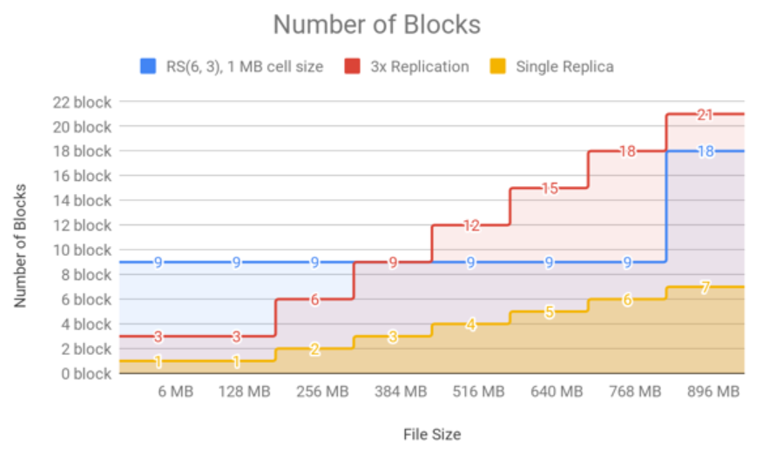
Replication vs Erasure Coding
I/O Cost, EC has higher I/O costs than replication (at least 10GB connection)
EC spreads data across nodes/racks, higher network cost
Parity block generated when data is written, lower write speed (but faster than writing >2 replicas)
If data missing/corrupt, a DataNode reads the remaining data/parity blocks, higher CPU and network costs
Storage Cost, EC has a lower storage overhead than replication
RS (6,3), HDFS stores 3 parity blocks for each set of 6 data blocks
Replication, HDFS stores 12 replica blocks for every six data blocks
File Size, EC works best with larger files
128 MB is default block size, with RS (6,3) each block group can hold up to (128 MB * 6)=768 MB
For a chunk of data less than the block size (e.g., 1 MB), replication writes 1 data block to 3 DataNodes
EC stripes data blocks and calculates parity blocks
If size <= data blocks * cell size, then # actual data blocks < #defined data blocks (with RS(6, 3) it is (6 * 1) MB)
But #parity blocks is the same (one data block, but three parity blocks)

Slide 36
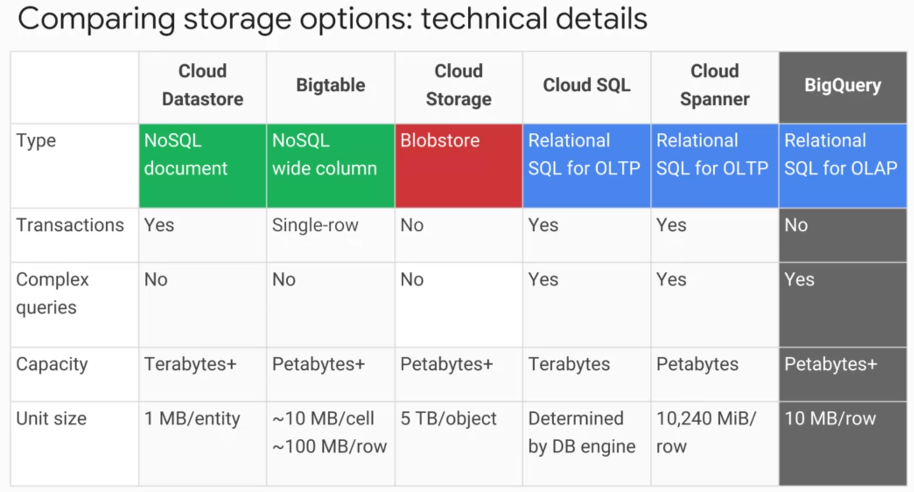
Storage: Google Cloud
Datastore: structured objects
Support transactions and SQL-like queries
TB capacity, max unit size 1MB
Best for semi-structured application data
Bigtable: many structured objects
No SQL queries and multi-row transactions
PB capacity, max unit size of 10MB/cell, 100MB/row
Best for analytical data with heavy read/write (e.g., IoT)
Cloud Storage: immutable blobs > 10 MB
PB capacity, max object size 5TB
Best for (un)structured binary data (images, backups)
Cloud SQL or Cloud Spanner for full SQL support
Cloud SQL (TB capacity), storing customer orders
Cloud Spanner (PB capacity), large scale applications > 2TB (e.g., e-commerce)
Horizontal scalability not just through read replicas
BigQuery on the edge between storage and processing

Slide 37
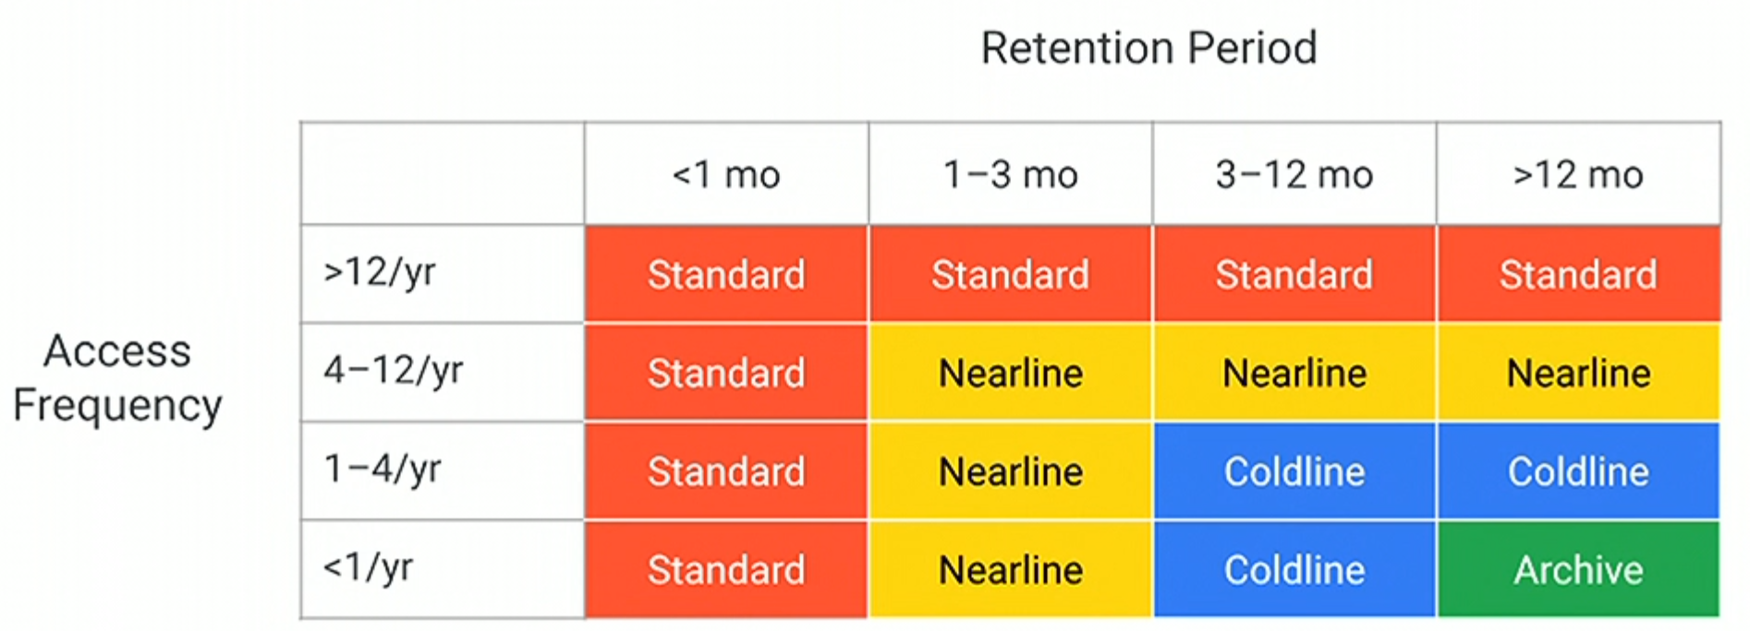
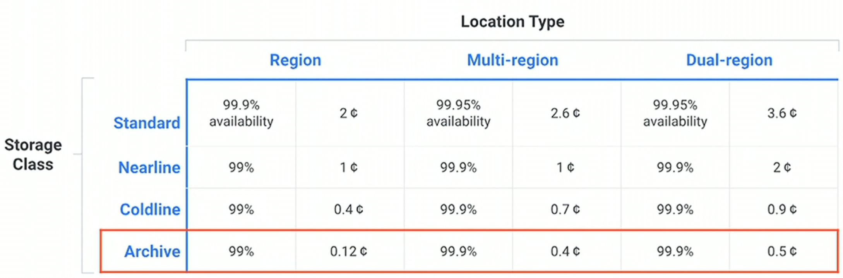
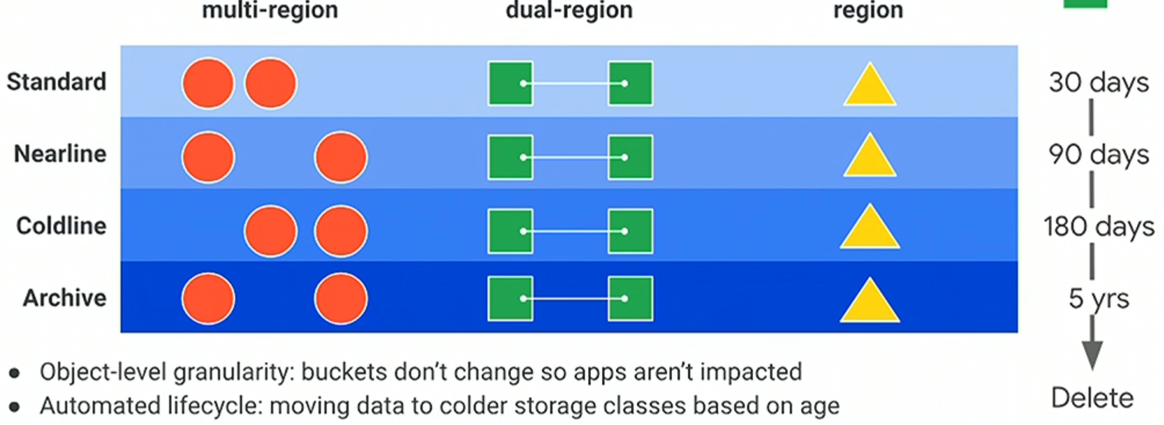
Storage: Google Cloud
Cloud Storage (2019)
Cloud Storage, classes determine availability and pricing
Standard: optimized for performance and high frequency access
Nearline: for data accessed less than once a month
Coldline: for data accessed less than once a quarter
Archive: most cost-effective, data accessed less than once a year
https://www.youtube.com/watch?time_continue=504&v=mOHy6m8KzJk

Slide 38
Storage: Google Big Table
Bigtable, distributed storage system for managing structured data (PB data across Ks servers)
Behind Gmail, Youtube, etc.
A Bigtable is a sparse, distributed, persistent multi-dimensional sorted map
Map is indexed by row key, column key, and timestamp; value is an uninterpreted array of bytes (row:string, column:string, time:int64) → string
The row keys in a table are arbitrary strings (up to 64KB in size)
Every read/write of data under a single row key is atomic (regardless number of columns)
Bigtable maintains data in lexicographic order by row key
Row range for a table is dynamically partitioned in tablets, the unit of distribution and load balancing
Reads of short row ranges are efficient and require communication a few machines
Column keys are grouped into sets called column families
Basic unit of access control, disk and memory accounting
All data stored in a column family is usually of the same type
Distinct column families in a table is small (~hundreds)
Families rarely change during operations
A table may have an unbounded number of columns

Slide 39
Storage: Google Big Table
Bigtable uses the distributed Google File System (GFS) to store log and data files
Bigtable cluster operates in a shared pool of machines
Bigtable processes often share the same machines with processes from other applications
SSTable file format is used internally to store Bigtable data
Persistent, ordered immutable map from keys to values (both are arbitrary byte strings)
Each SSTable contains a sequence of blocks (typically 64KB in size, but this is configurable)
A block index (stored at the end of SSTable) locates blocks, loaded into memory when SSTable is opened
Operations
Look up value associated with specific key. Performed with a single disk seek
Find the appropriate block by performing a binary search in the in-memory index
Read appropriate block from disk
Iterate over all key/value pairs in a specified key range
Relies on a highly-available and persistent distributed lock service called Chubby
Chubby provides a namespace that consists of directories and small files
Each directory or file can be used as a lock, and reads and writes to a file are atomic
Bigtable uses Chubby to ensure at most one active master at any time; and to store bootstrap location of Bigtable data

Slide 40
Storage: Google Big Table
Bigtable implementation has three major components
A library that is linked into every client
Clients communicate directly with tablet servers for reads and writes
Most clients never communicate with the master
Many tablet servers
Tablet server handles read and write requests to the tablets that it has loaded
Splits tablets that have grown too large (100-200 MB in size by default)
Client data does not move through the master
One master server
Assigns tablets to tablet servers
Detects the addition / expiration of tablet servers
Balance tablet-server load and garbage collection of files in GFSA Bigtable cluster stores a number of tables

Slide 41
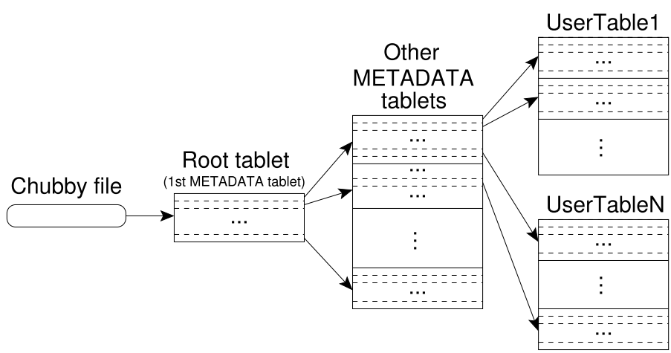
Storage: Google Big Table
Table consists of tablets, each tablet contains data associated with row range
Initially, each table consists of just one tablet
Three-level hierarchy analogous to that of a B⁺-tree
First level is a file stored in Chubby that contains the location of root tablet
Contains locations of all tablets in a special METADATA table
It is never split to ensure that the tablet location hierarchy has no more than three levels
METADATA table stores location of a tablet under a row key encoding tablet’s table identifier and end row
Contains locations of a set of user tablets
Each METADATA row stores approximately 1KB of data in memory
With 128 MB METADATA tablets, three-level location scheme addresses 234 tablets
The client library caches tablet locations
If the client does not know the location of a tablet, then it recursively moves up the tablet location hierarchy

Slide 42
Storage: Data Migration
Moving data to the cloud
80TB of data to move
1Gbps connection to the internet
How many days?
80000 / (1 / 8) / 60 / 60 / 24 ~= a week without internet
AWS Snowball (up to 80 TB)
Physical device connected network in data center
Leverage local network to copy the data
Import/export data between on-premises data storage locations and S3
What if we have EB of data?
…
YB 10²⁴
ZB 10²¹
EB 10¹⁸
PB 10¹⁵
TB 10¹²
GB 10⁹
MB 10⁶
KB 10³
B 10⁰

Slide 43
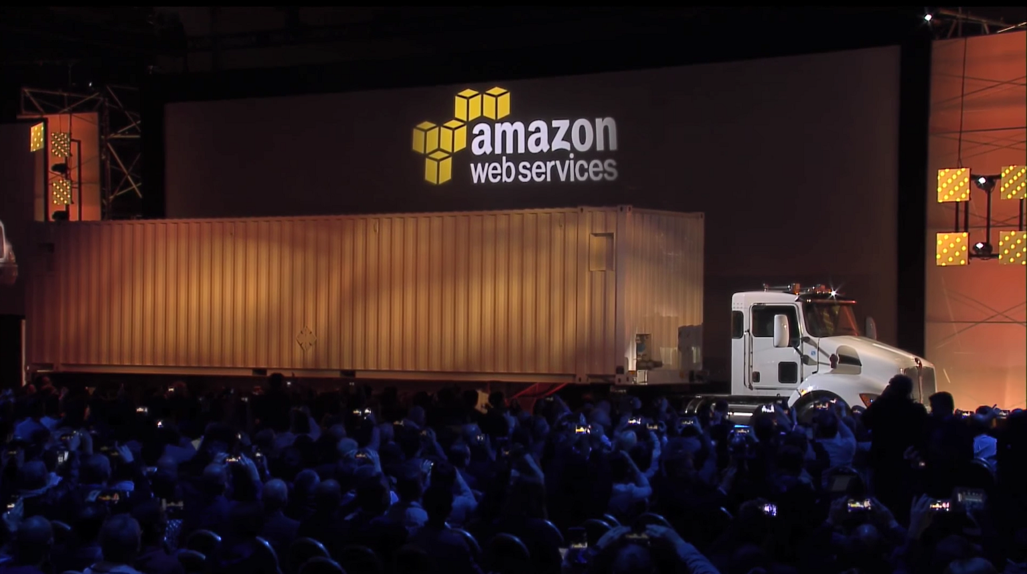
What if we have EB of data? AWS Snowmobile

Slide 44


Slide 45
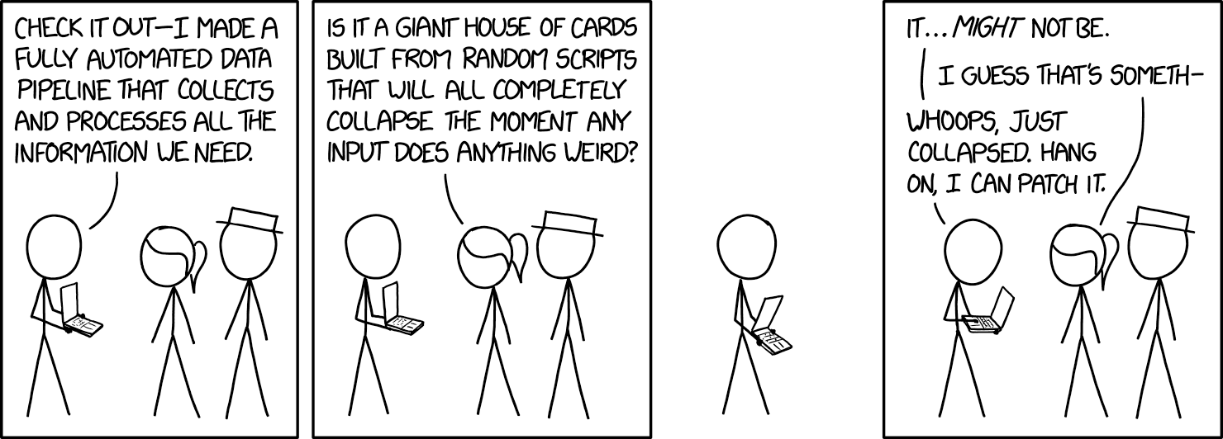
Analysis: Paradigms of Parallel Computing in Cloud
Big data analytics may be the most widely used cloud computational capability
Batch: collect all data, compute once
(Near-)Real-time: collect some data, process many times

Slide 46
Analysis: Batch Parallel Computing
Original Hadoop MapReduce tools first used to perform largescale data analytics in the cloud have now morphed into a vast suite of open source systems that are constantly being improved and extended
PaaS, environment to develop/run applications without set up/maintain HW and SW infrastructures
Public clouds originally created as internal data centers to support services involving large data collections.
To optimize these services, companies started performing massive amounts of analysis on those data.
Single program multiple data (SPMD) computing
Supercomputer applications
Often the first that scientific programmers want to try when they meet the cloud
Many task parallelism (bag of task)
Queues of tasks executed in any order, with results stored in a DB or files, or used to define new tasks
E.g., to analyze many data samples place all samples in queues, then start many workers
Bulk synchronous parallelism (BSP)
Processes or threads performing independent computations, exchange data, and synchronize at a barrier
When reach a barrier, stop until all other threads/processes in synchronization group reach the same point
E.g., MapReduce. Given data objects X_{i} for i = 1..n apply a function f(x) to each element, we want to compute sum. We map f over the data and then reduce by performing the sum
Graph execution model
Computation represented by a directed (acyclic) graph of tasks
Execution begins at a source of the graph. Each node is scheduled for execution when all incoming edges come from task nodes that have completed. If graph is linear sequence of nodes, then execution is BSP
E.g., Spark and Spark Streaming, Apache Flink, Storm, Google Dataflow, Google TensorFlow
Microservices and actors
In the actor model of parallel programming, computing is performed by many actors that communicate via messages. Each actor has its own internal private memory and goes into action when it receives a message. Based on the message, it can change its internal state and then send messages to other actors. You can implement an actor as a simple web service. If you limit the service to being largely stateless, you are now in the realm of microservices, a dominant design paradigm for large cloud applications.
Microservices are often implemented as container instances, and they depend on robust container management infrastructure such as Mesos [154] and Kubernetes [79]

Slide 47
Analysis
Deploying Hadoop on a cluster used to require a team of systems professionals.
Amazon’s Elastic MapReduce (EMR) service makes creating a YARN cluster trivial
Select your favorite combination of tools from their preconfigured lists
Specify the instance type and number of worker nodes that you want (HDFS, YARN, Spark, Zeppelin)
In about two minutes you are up and running
Athena
Query data in Amazon S3 without having to launch VM instances
Serverless computing
Object searchlog is extracted from a file
Athena treats data in S3 as read-only, and all transformations are made in the internal Athena engine and storage. Once you have your data defined, you can explore them with the query editor and visualize results with other tools such as Amazon QuickSight. Athena is designed to make performing interactive analytics on large data collections easy

Slide 48
Analysis
Google Cloud
BigQuery
While Athena is based on the standard S3 blob store, BigQuery builds on a special data warehouse.
Google’s latest addition to BigQuery is a Jupyter-based tool called Datalab (either on portal or on laptop)

Slide 49
Analysis: Stream Parallel Computing
Streaming systems, data in an unbounded stream are unbounded in time.
Cannot wait until the end of time to present results, present results at the end of a reasonable time window
Distributed processing and short time window prevent to know global state, events missed or counted twice
Strongly consistent event systems guarantee that each event is processed once and only once.
Weakly consistent system may give you only approximate results
Can verify results by performing a batch run on each daily checkpoint file with additional work and delays
Streaming system can combine streaming engine with separate batch system (lambda architecture)
Semantics of time and windows
Distinguish between event time (when pushed into stream) and processing time
Events may be processed out of event-time order, several types of time windows exist
Fixed time windows divide incoming stream into logical segments, intervals do not overlap
Sliding windows allow for the windows to overlap
Per session windows divide the stream into sessions of activity related to some key in the data

Slide 50
Analysis: Stream Parallel Computing
Amazon Kinesis
Kinesis Streams provides ordered, replayable real-time streaming data
Each Kinesis stream is composed of one or more shards (e.g., a rope composed of many strands/shards)
Data moving through stream are spread across the individual shards that make up the stream
Data producers write to the shards and consumers read from the shards
Each shard can support writes from producers at up to 1,000 records per second, up to a maximum data write total of 1 MB per second. However, no individual record can be bigger than 1 MB. On the other hand, reads by data consumers can be at most five transactions per second, with a total throughput of 2 MB/sec. While these bounds may seem rather limiting, you can have streams with thousands of shards.
Biggest limitation may be the 1 MB limit on the size of each event, which means that big events must split up and spread over multiple shards
Kinesis Firehose, designed for extreme scale, can load data directly into S3 or other Amazon services
Kinesis Firehose is designed to handle large streams of data that are automatically delivered to S3 or Amazon Redshift. Firehose is batch oriented: it buffers incoming data into buffers of up to 128 MB and dumps the buffer to your S3 blobs at specific intervals that you select, from every minute to every 15 minutes. You can also specify that the data be compressed and/or encrypted. Consequently Firehose is not designed for real-time analysis but for near-real-time large-scale analysis.
Kinesis Analytics provides SQL-based tools for real-time analysis from Kinesis Streams or Firehose
Kinesis with Spark
Spark has a streaming subsystem called Spark Streaming. The key concept is that of a D-stream, which takes windows of streamed data and blocks them into Spark RDDs for analysis
We create a pseudo D-Stream by pulling blocks of events from Kinesis and converting each block into a Spark RDD

Slide 51
Analysis: Stream Parallel Computing
Apache Beam (open source release of the Google Cloud Dataflow system)
Beam treats the batch and streaming cases uniformly
Concepts
Pipelines encapsulate computation
PCollections represent data as they move through a pipeline
A PCollection can comprise either a large but fixed-size set of elements or a potentially unbounded stream. The elements in any PCollection are all of the same type, but that type may be any serializable Java type. The creator of a PCollection often appends a timestamp to each element at creation time, particularly when dealing with unbounded collections. One important type of PCollection that is often used is the key-value PCollection, KV<K, V>, where K and V are the key and value types, respectively. Note that PCollections are immutable: you cannot change them, but you can apply transforms to translate them into new PCollections.
Computational transformations that operate on PCollections and produce Pcollections
Sources and Sinks from which data are read and to which data are written

Slide 52
Analysis: Machine Learning
Machine learning has become central to applications of cloud computing
Speech recognition [144], real-time automatic language translation [95], computer vision [74]
Reinforcement learning that allow machines to master some human games, such as Go [234].
Breakthroughs
Availability of big data
Algorithmic advances
Computational power
Spark MLlib
Set of high-level APIs for creating ML pipelines
DataFrames are containers created from Spark RDDs to hold vectors and other structured types in a manner that permits efficient execution [45] (similar to Pandas DataFrames)
Transformers are operators that convert one DataFrame to another. Since they are nodes on the execution graph, they are not evaluated until the entire graph is executed. Estimators encapsulate ML and other algorithms. As we describe in the following, you can use the fit(...) method to pass a DataFrame and parameters to a learning algorithm to create a model. The model is now represented as a Transformer. Many transformers exist, for example to turn text documents into vectors of real numbers, convert columns of a DataFrame from one form to another, or split DataFrames into subsets. There are also various kinds of estimators, ranging from those that transform vectors by projecting them onto principal component vectors, to ngram generators that take text documents and return strings of n consecutive words. Classification models include logistic regression, decision tree classifiers, random forests, and naive Bayes. The family of clustering methods includes k-means and latent Dirichlet allocation (LDA). The MLlib online documentation provides much useful material on these and related topics [29] .
A Pipeline (usually linear, but can be a directed acyclic graph) links Transformers and Estimators to specify an ML workflow. Pipelines inherit the fit(...) method from the contained estimator. Once the estimator is trained, the pipeline is a model and has a transform(...) method that can be used to push new cases through the pipeline to make predictions.

Slide 53

Analysis: Machine Learning
Amazon Lex incorporates voice input into applications, extension Amazon’s Echo
Lex as a service, allow voice commands to Echo to launch lambda function
NASA has built a replica of the NASA Mars rover that can be controlled by voice commands [189].
Amazon Polly turns text into speech
27 languages with a variety of voices, control pronunciation and other aspects of intonation
Together with Lex, makes a first step toward conversational computing (no real-time)
Amazon Rekognition cutting edge of deep learning applications
Trained with many thousands of captioned images
Considers million images containing a cat, each with an associated caption that mentions “cat”
Amazon Machine Learning creates predictive models based on training data
ML dashboard presents list of experiments, models, and data sources from previous ML work
From dashboard, define data sources and ML models, create evaluations, and run batch predictions

Slide 54
Analysis: Machine Learning
Google’s TensorFlow deep learning toolkit.

Slide 55
Serverless computing
Build and run applications without thinking about servers
Application still runs on servers, but all the server management is done by cloud provider
Serverless computing is a cloud computing execution model in which the cloud provider runs the server, and dynamically manages the allocation of machine resources. Pricing is based on the actual amount of resources consumed by an application, rather than on pre-purchased units of capacity.^{[1]} It can be a form of utility computing.
Serverless computing can simplify the process of deploying code into production.
AWS Lambda, introduced by Amazon in 2014
Google Cloud Functions since 2016
Microsoft Azure offers Azure Functions
What is AWS Lambda?
Amazon EC2 offers flexibility, customize operating system, network and security settings
Allowing to easily move existing applications to the cloud.
You are responsible for provisioning capacity, monitoring fleet health and performance, and designing for fault tolerance and scalability
AWS Lambda makes it easy to execute code in response to events, such as changes to Amazon S3 buckets, updates to an Amazon DynamoDB table, or custom events generated by your applications or devices.
Do not have to provision your own instances; Lambda performs all the operational and administrative activities on your behalf, including capacity provisioning, monitoring fleet health, applying security patches to the underlying compute resources, deploying your code, running a web service front end, and monitoring and logging your code.
AWS Lambda provides easy scaling and high availability to your code without additional effort on your part.
Pay only for the compute time you consume, no charge when your code is not running
You can set up your code to automatically trigger from other AWS services
Each AWS Lambda function runs in its own isolated environment, with its own resources and file system view. AWS Lambda uses the same techniques as Amazon EC2 to provide security and separation at the infrastructure and execution levels.
AWS Lambda stores code in Amazon S3 and encrypts it at rest. AWS Lambda performs additional integrity checks while your code is in use.
Triggers
Services that invoke Lambda functions synchronously
Elastic Load Balancing (Application Load Balancer), Amazon Alexa
Services that invoke Lambda functions asynchronously
Lambda queues the event before passing it to your function
The other service gets a success response as soon as the event is queued and isn't aware of what happens afterwards
If an error occurs, Lambda handles retries, and can send failed events to a destination that you configure.
Sources: Amazon Simple Storage Service, AWS CodeCommit, AWS IoT
AWS Lambda functions
Q: What is an AWS Lambda function?
The code you run on AWS Lambda is uploaded as a “Lambda function”. Each function has associated configuration information, such as its name, description, entry point, and resource requirements. The code must be written in a “stateless” style i.e. it should assume there is no affinity to the underlying compute infrastructure. Local file system access, child processes, and similar artifacts may not extend beyond the lifetime of the request, and any persistent state should be stored in Amazon S3, Amazon DynamoDB, or another Internet-available storage service. Lambda functions can include libraries, even native ones.
Q: Will AWS Lambda reuse function instances?
To improve performance, AWS Lambda may choose to retain an instance of your function and reuse it to serve a subsequent request, rather than creating a new copy. To learn more about how Lambda reuses function instances, visit our documentation. Your code should not assume that this will always happen.
Q: What if I need scratch space on disk for my AWS Lambda function?
Each Lambda function receives 500MB of non-persistent disk space in its own /tmp directory.
Q: Why must AWS Lambda functions be stateless?
Keeping functions stateless enables AWS Lambda to rapidly launch as many copies of the function as needed to scale to the rate of incoming events. While AWS Lambda’s programming model is stateless, your code can access stateful data by calling other web services, such as Amazon S3 or Amazon DynamoDB.
Q: Can I use threads and processes in my AWS Lambda function code?
Yes. AWS Lambda allows you to use normal language and operating system features, such as creating additional threads and processes. Resources allocated to the Lambda function, including memory, execution time, disk, and network use, must be shared among all the threads/processes it uses. You can launch processes using any language supported by Amazon Linux.
Q: What restrictions apply to AWS Lambda function code?
Lambda attempts to impose as few restrictions as possible on normal language and operating system activities, but there are a few activities that are disabled: Inbound network connections are blocked by AWS Lambda, and for outbound connections only TCP/IP and UDP/IP sockets are supported, and ptrace (debugging) system calls are blocked. TCP port 25 traffic is also blocked as an anti-spam measure.
Q: How do I create an AWS Lambda function using the Lambda console?
If you are using Node.js or Python, you can author the code for your function using code editor in the AWS Lambda console which lets you author and test your functions, and view the results of function executions in a robust, IDE-like environment. Go to the console to get started.
You can also package the code (and any dependent libraries) as a ZIP and upload it using the AWS Lambda console from your local environment or specify an Amazon S3 location where the ZIP file is located. Uploads must be no larger than 50MB (compressed). You can use the AWS Eclipse plugin to author and deploy Lambda functions in Java. You can use the Visual Studio plugin to author and deploy Lambda functions in C#, and Node.js.
Q: How do I create an AWS Lambda function using the Lambda CLI?
You can package the code (and any dependent libraries) as a ZIP and upload it using the AWS CLI from your local environment, or specify an Amazon S3 location where the ZIP file is located. Uploads must be no larger than 50MB (compressed). Visit the Lambda Getting Started guide to get started.
Q: Does AWS Lambda support environment variables?
Yes. You can easily create and modify environment variables from the AWS Lambda Console, CLI or SDKs. To learn more about environment variables, see the documentation.
Q: Can I store sensitive information in environment variables?
For sensitive information, such as database passwords, we recommend you use client-side encryption using AWS Key Management Service and store the resulting values as ciphertext in your environment variable. You will need to include logic in your AWS Lambda function code to decrypt these values.
Q: How can I manage my AWS Lambda functions?
You can easily list, delete, update, and monitor your Lambda functions using the dashboard in the AWS Lambda console. You can also use the AWS CLI and AWS SDK to manage your Lambda functions. Visit the Lambda Developer Guide to learn more.
Q: Can I share code across functions?
Yes, you can package any code (frameworks, SDKs, libraries, and more) as a Lambda Layer and manage and share them easily across multiple functions.
Q: How do I monitor an AWS Lambda function?
AWS Lambda automatically monitors Lambda functions on your behalf, reporting real-time metrics through Amazon CloudWatch, including total requests, account-level and function-level concurrency usage, latency, error rates, and throttled requests. You can view statistics for each of your Lambda functions via the Amazon CloudWatch console or through the AWS Lambda console. You can also call third-party monitoring APIs in your Lambda function.
Visit Troubleshooting CloudWatch metrics to learn more. Standard charges for AWS Lambda apply to use Lambda’s built-in metrics.
Q: How do I troubleshoot failures in an AWS Lambda function?
AWS Lambda automatically integrates with Amazon CloudWatch logs, creating a log group for each Lambda function and providing basic application lifecycle event log entries, including logging the resources consumed for each use of that function. You can easily insert additional logging statements into your code. You can also call third-party logging APIs in your Lambda function. Visit Troubleshooting Lambda functions to learn more. Amazon CloudWatch Logs rates will apply.
Q: How do I scale an AWS Lambda function?
You do not have to scale your Lambda functions – AWS Lambda scales them automatically on your behalf. Every time an event notification is received for your function, AWS Lambda quickly locates free capacity within its compute fleet and runs your code. Since your code is stateless, AWS Lambda can start as many copies of your function as needed without lengthy deployment and configuration delays. There are no fundamental limits to scaling a function. AWS Lambda will dynamically allocate capacity to match the rate of incoming events.
Q: How are compute resources assigned to an AWS Lambda function?
In the AWS Lambda resource model, you choose the amount of memory you want for your function, and are allocated proportional CPU power and other resources. For example, choosing 256MB of memory allocates approximately twice as much CPU power to your Lambda function as requesting 128MB of memory and half as much CPU power as choosing 512MB of memory. To learn more, see our Function Configuration documentation. You can set your memory in 64MB increments from 128MB to 3GB.
Q: How long can an AWS Lambda function execute?
AWS Lambda functions can be configured to run up to 15 minutes per execution. You can set the timeout to any value between 1 second and 15 minutes.
Q: How will I be charged for using AWS Lambda functions?
AWS Lambda is priced on a pay per use basis. Please see the AWS Lambda pricing page for details.
Q: Can I save money on AWS Lambda with a Compute Savings Plan?
Yes. In addition to saving money on Amazon EC2 and AWS Fargate, you can also use Compute Savings Plans to save money on AWS Lambda. Compute Savings Plans offer up to 17% discount on Duration, Provisioned Concurrency, and Duration (Provisioned Concurrency). Compute Savings Plans do not offer a discount on Requests in your Lambda bill. However, your Compute Savings Plans commitment can apply to Requests at regular rates.
Q: Does AWS Lambda support versioning?
Yes. By default, each AWS Lambda function has a single, current version of the code. Clients of your Lambda function can call a specific version or get the latest implementation. Please read out documentation on versioning Lambda functions.
Q: How long after uploading my code will my AWS Lambda function be ready to call?
Deployment times may vary with the size of your code, but AWS Lambda functions are typically ready to call within seconds of upload.
Q: Can I use my own version of a supported library?
Yes. you can include your own copy of a library (including the AWS SDK) in order to use a different version than the default one provided by AWS Lambda.
Using AWS Lambda to process AWS events
Q: What is an event source?
An event source is an AWS service or developer-created application that produces events that trigger an AWS Lambda function to run. Some services publish these events to Lambda by invoking the cloud function directly (for example, Amazon S3). Lambda can also poll resources in other services that do not publish events to Lambda. For example, Lambda can pull records from an Amazon Kinesis stream or an Amazon SQS queue and execute a Lambda function for each fetched message.
Many other services, such as AWS CloudTrail, can act as event sources simply by logging to Amazon S3 and using S3 bucket notifications to trigger AWS Lambda functions.
Q: What event sources can be used with AWS Lambda?
Please see our documentation for a complete list of event sources.
Q: How are events represented in AWS Lambda?
Events are passed to a Lambda function as an event input parameter. For event sources where events arrive in batches, such as Amazon SQS, Amazon Kinesis, and Amazon DynamoDB Streams, the event parameter may contain multiple events in a single call, based on the batch size you request.To learn more about Amazon S3 event notifications visit Configuring Notifications for Amazon S3 Events. To learn more about Amazon DynamoDB Streams visit the DynamoDB Stream Developers Guide. To learn more about invoking Lambda functions using Amazon SNS, visit the Amazon SNS Developers Guide. For more information on Amazon Cognito events, visit Amazon Cognito. For more information on AWS CloudTrail logs and auditing API calls across AWS services, see AWS CloudTrail.
Q: How do I make an AWS Lambda function respond to changes in an Amazon S3 bucket?
From the AWS Lambda console, you can select a function and associate it with notifications from an Amazon S3 bucket. Alternatively, you can use the Amazon S3 console and configure the bucket’s notifications to send to your AWS Lambda function. This same functionality is also available through the AWS SDK and CLI.
Q: How do I make an AWS Lambda function respond to updates in an Amazon DynamoDB table?
You can trigger a Lambda function on DynamoDB table updates by subscribing your Lambda function to the DynamoDB Stream associated with the table. You can associate a DynamoDB Stream with a Lambda function using the Amazon DynamoDB console, the AWS Lambda console or Lambda’s registerEventSource API.
Q: How do I use an AWS Lambda function to process records in an Amazon Kinesis stream?
From the AWS Lambda console, you can select a Lambda function and associate it with an Amazon Kinesis stream owned by the same account. This same functionality is also available through the AWS SDK and CLI.
Q: How does AWS Lambda process data from Amazon Kinesis streams and Amazon DynamoDB Streams?
The Amazon Kinesis and DynamoDB Streams records sent to your AWS Lambda function are strictly serialized, per shard. This means that if you put two records in the same shard, Lambda guarantees that your Lambda function will be successfully invoked with the first record before it is invoked with the second record. If the invocation for one record times out, is throttled, or encounters any other error, Lambda will retry until it succeeds (or the record reaches its 24-hour expiration) before moving on to the next record. The ordering of records across different shards is not guaranteed, and processing of each shard happens in parallel.
Q: How do I use an AWS Lambda function to respond to notifications sent by Amazon Simple Notification Service (SNS)?
From the AWS Lambda console, you can select a Lambda function and associate it with an Amazon SNS topic. This same functionality is also available through the AWS SDK and CLI.
Q: How do I use an AWS Lambda function to respond to emails sent by Amazon Simple Email Service (SES)?
From the Amazon SES Console, you can set up your receipt rule to have Amazon SES deliver your messages to an AWS Lambda function. The same functionality is available through the AWS SDK and CLI.
Q: How do I use an AWS Lambda function to respond to Amazon CloudWatch alarms?
First, configure the alarm to send Amazon SNS notifications. Then from the AWS Lambda console, select a Lambda function and associate it with that Amazon SNS topic. See the Amazon CloudWatch Developer Guide for more on setting up Amazon CloudWatch alarms.
Q: How do I use an AWS Lambda function to respond to changes in user or device data managed by Amazon Cognito?
From the AWS Lambda console, you can select a function to trigger when any datasets associated with an Amazon Cognito identity pool are synchronized. This same functionality is also available through the AWS SDK and CLI. Visit Amazon Cognito for more information on using Amazon Cognito to share and synchronize data across a user’s devices.
Q: How can my application trigger an AWS Lambda function directly?
You can invoke a Lambda function using a custom event through AWS Lambda’s invoke API. Only the function’s owner or another AWS account that the owner has granted permission can invoke the function. Visit the Lambda Developers Guide to learn more.
Q: What is the latency of invoking an AWS Lambda function in response to an event?
AWS Lambda is designed to process events within milliseconds. Latency will be higher immediately after a Lambda function is created, updated, or if it has not been used recently.
Q: How do I create a mobile back-end using AWS Lambda?
You upload the code you want AWS Lambda to execute and then invoke it from your mobile app using the AWS Lambda SDK included in the AWS Mobile SDK. You can make both direct (synchronous) calls to retrieve or check data in real time as well as asynchronous calls. You can also define a custom API using Amazon API Gateway and invoke your Lambda functions through any REST compatible client. To learn more about the AWS Mobile SDK, visit the AWS Mobile SDK page. To learn more about Amazon API Gateway, visit the Amazon API Gateway page.
Q: How do I invoke an AWS Lambda function over HTTPS?
You can invoke a Lambda function over HTTPS by defining a custom RESTful API using Amazon API Gateway. This gives you an endpoint for your function which can respond to REST calls like GET, PUT and POST. Read more about using AWS Lambda with Amazon API Gateway.
Q: How can my AWS Lambda function customize its behavior to the device and app making the request?
When called through the AWS Mobile SDK, AWS Lambda functions automatically gain insight into the device and application that made the call through the ‘context’ object.
Q: How can my AWS Lambda function personalize their behavior based on the identity of the end user of an application?
When your app uses the Amazon Cognito identity, end users can authenticate themselves using a variety of public login providers such as Amazon, Facebook, Google, and other OpenID Connect-compatible services. User identity is then automatically and secured presented to your Lambda function in the form of an Amazon Cognito id, allowing it to access user data from Amazon Cognito, or as a key to store and retrieve data in Amazon DynamoDB or other web services.
Q: How do I create an Alexa skill using AWS Lambda?
AWS Lambda is integrated with the Alexa Skills Kit, a collection of self-service APIs, tools, documentation and code samples that make it easy for you to create voice-driven capabilities (or “skills”) for Alexa. You simply upload the Lambda function code for the new Alexa skill you are creating, and AWS Lambda does the rest, executing the code in response to Alexa voice interactions and automatically managing the compute resources on your behalf. Read the Alexa Skills Kit documentation for more details.
Q: What happens if my function fails while processing an event?
For Amazon S3 bucket notifications and custom events, AWS Lambda will attempt execution of your function three times in the event of an error condition in your code or if you exceed a service or resource limit. For ordered event sources that AWS Lambda polls on your behalf, such as Amazon DynamoDB Streams and Amazon Kinesis streams, Lambda will continue attempting execution in the event of a developer code error until the data expires. You can monitor progress through the Amazon Kinesis and Amazon DynamoDB consoles and through the Amazon CloudWatch metrics that AWS Lambda generates for your function. You can also set Amazon CloudWatch alarms based on error or execution throttling rates.
Using AWS Lambda to build applications
Q: What is a serverless application?
Lambda-based applications (also referred to as serverless applications) are composed of functions triggered by events. A typical serverless application consists of one or more functions triggered by events such as object uploads to Amazon S3, Amazon SNS notifications, or API actions. These functions can stand alone or leverage other resources such as DynamoDB tables or Amazon S3 buckets. The most basic serverless application is simply a function.
Q: How do I deploy and manage a serverless application?
You can deploy and manage your serverless applications using the AWS Serverless Application Model (AWS SAM). AWS SAM is a specification that prescribes the rules for expressing serverless applications on AWS. This specification aligns with the syntax used by AWS CloudFormation today and is supported natively within AWS CloudFormation as a set of resource types (referred to as "serverless resources"). These resources make it easier for AWS customers to use CloudFormation to configure and deploy serverless applications, using existing CloudFormation APIs.
Q: How can I discover existing serverless applications developed by the AWS community?
You can choose from a collection of serverless applications published by developers, companies, and partners in the AWS community with the AWS Serverless Application Repository. After finding an application, you can configure and deploy it straight from the Lambda console.
Q: How do I automate deployment for a serverless application?
You can automate your serverless application’s release process using AWS CodePipeline and AWS CodeDeploy. CodePipeline is a continuous delivery service that enables you to model, visualize and automate the steps required to release your serverless application. CodeDeploy provides a deployment automation engine for your Lambda-based applications. CodeDeploy lets you orchestrate deployments according to established best-practice methodologies such as canary and linear deployments, and helps you establish the necessary guardrails to verify that newly-deployed code is safe, stable, and ready to be fully released to production.
To learn more about serverless CI/CD, visit our documentation.
Q: How do I get started on building a serverless application?
To get started, visit the AWS Lambda console and download one of our blueprints. The file you download will contain an AWS SAM file (which defines the AWS resources in your application), and a .ZIP file (which includes your function’s code). You can then use AWS CloudFormation commands to package and deploy the serverless application that you just downloaded. For more details, visit our documentation.
Q: How do I coordinate calls between multiple AWS Lambda functions?
You can use AWS Step Functions to coordinate a series of AWS Lambda functions in a specific order. You can invoke multiple Lambda functions sequentially, passing the output of one to the other, and/or in parallel, and Step Functions will maintain state during executions for you.
Q: How do I troubleshoot a serverless application?
You can enable your Lambda function for tracing with AWS X-Ray by adding X-Ray permissions to your Lambda function’s execution role and changing your function’s “tracing mode” to “active. ” When X-Ray is enabled for your Lambda function, AWS Lambda will emit tracing information to X-Ray regarding the Lambda service overhead incurred when invoking your function. This will provide you with insights such as Lambda service overhead, function init time, and function execution time. In addition, you can include the X-Ray SDK in your Lambda deployment package to create your own trace segments, annotate your traces, or view trace segments for downstream calls made from your Lambda function. X-Ray SDKs are currently available for Node.js and Java. Visit Troubleshooting Lambda-based applications to learn more. AWS X-Ray rates will apply.
Q. Can I build serverless applications that connect to relational databases?
Yes. You can build highly scalable, secure, Lambda-based serverless applications that connect to relational databases using Amazon RDS Proxy, a highly available database proxy that manages thousands of concurrent connections to relational databases. Currently, RDS Proxy supports MySQL and Aurora databases. You can begin using RDS Proxy through the Amazon RDS console or the AWS Lambda console. Serverless applications that use fully managed connection pools from RDS Proxy will be billed according to RDS Proxy Pricing.
Q: How is AWS SAM licensed?
The specification is open sourced under Apache 2.0, which allows you and others to adopt and incorporate AWS SAM into build, deployment, monitoring and management tools with a commercial-friendly license. You can access the AWS SAM repository on GitHub here.
Provisioned Concurrency
Q: What is AWS Lambda Provisioned Concurrency?
Provisioned Concurrency gives you greater control over the performance of your serverless applications. When enabled, Provisioned Concurrency keeps functions initialized and hyper-ready to respond in double-digit milliseconds.
Q: How do I set up and manage Provisioned Concurrency?
You can configure concurrency on your function through the AWS Management Console, the Lambda API, the AWS CLI, and AWS CloudFormation. The simplest way to benefit from Provisioned Concurrency is by using AWS Auto Scaling. You can use Application Auto Scaling to configure schedules, or have Auto Scaling automatically adjust the level of Provisioned Concurrency in real time as demand changes. To learn more about Provisioned Concurrency, see the documentation.
Q: Do I need to change my code if I want to use Provisioned Concurrency?
You don’t need to make any changes to your code to use Provisioned Concurrency. It works seamlessly with all existing functions and runtimes. There is no change to the invocation and execution model of Lambda when using Provisioned Concurrency.
Q: How will I be charged for Provisioned Concurrency?
Provisioned Concurrency adds a pricing dimension, of ‘Provisioned Concurrency’, for keeping functions initialized. When enabled, you pay for the amount of concurrency that you configure and for the period of time that you configure it. When your function executes while Provisioned Concurrency is configured on it, you also pay for Requests and execution Duration. To learn more about the pricing of Provisioned Concurrency, see AWS Lambda Pricing.
Q: When should I use Provisioned Concurrency?
Provisioned Concurrency is ideal for building latency-sensitive applications, such as web or mobile backends, synchronously invoked APIs, and interactive microservices. You can easily configure the appropriate amount of concurrency based on your application's unique demand. You can increase the amount of concurrency during times of high demand and lower it, or turn it off completely, when demand decreases.
Q: What happens if a functions receives invocations above the configured level of Provisioned Concurrency?
If the concurrency of a function reaches the configured level, subsequent invocations of the function have the latency and scale characteristics of regular Lambda functions. You can restrict your function to only scale up to the configured level. Doing so prevents the function from exceeding the configured level of Provisioned Concurrency. This is a mechanism to prevent undesired variability in your application when demand exceeds the anticipated amount.
Amazon EFS for AWS Lambda
Q: What is Amazon EFS for AWS Lambda?
With Amazon Elastic File System (Amazon EFS) for AWS Lambda, customers can securely read, write and persist large volumes of data at virtually any scale using a fully managed elastic NFS file system that can scale on demand without the need for provisioning or capacity management. Previously, developers added code to their functions to download data from S3 or databases to local temporary storage, limited to 512MB. With EFS for Lambda, developers don't need to write code to download data to temporary storage in order to process it.
Q: How do I set up Amazon EFS for Lambda?
Developers can easily connect an existing EFS file system to a Lambda function via an EFS Access Point by using the console, CLI or SDK. When the function is first invoked, the file system is automatically mounted and made available to function code. You can learn more in the documentation.
Q: Do I need to configure my function with VPC settings before I can use my Amazon EFS file system?
Yes. Mount targets for Amazon EFS are associated with a subnets in a VPC. The AWS Lambda function needs to be configured to access that VPC. Q: Who should use Amazon EFS for Lambda?
Using EFS for Lambda is ideal for building machine learning applications or loading large reference files or models, processing or backing up large amounts of data, hosting web content, or developing internal build systems. Customers can also use EFS for Lambda to keep state between invocations within a stateful microservice architecture, in a StepFunctions workflow, or sharing files between serverless applications and instance or container-based applications.
Q: Will my data be encrypted in transit?
Yes. Data encryption in transit uses industry standard Transport Layer Security (TLS) 1.2 to encrypt data sent between AWS Lambda functions and the Amazon EFS file systems.
Q: Is my data encrypted at rest?
Customers can provision Amazon EFS to encrypt data at rest. Data encrypted at rest is transparently encrypted while being written, and transparently decrypted while being read, so you don’t have to modify your applications. Encryption keys are managed by the AWS Key Management Service (KMS), eliminating the need to build and maintain a secure key management infrastructure.
Q: How will I be charged for Amazon EFS for AWS Lambda?
There is no additional charge for using Amazon EFS for AWS Lambda. Customers pay the standard price for AWS Lambda and for Amazon EFS. When using Lambda and EFS in the same availability zone, customers are not charged for data transfer. However, if they use VPC peering for Cross-Account access, they will incur data transfer charges. To learn more, please see Pricing.
Q: Can I associate more than one Amazon EFS file system with my AWS Lambda function?
No. Each Lambda function will be able to access one EFS file system.
Q: Can I use the same Amazon EFS file system across multiple functions, containers, and instances?
Yes. Amazon EFS supports Lambda functions, ECS and Fargate containers, and EC2 instances. You can share the same file system and use IAM policy and Access Points to control what each function, container, or instance has access to.
Lambda@Edge
Q: What is Lambda@Edge?
Lambda@Edge allows you to run code across AWS locations globally without provisioning or managing servers, responding to end users at the lowest network latency. You just upload your Node.js or Python code to AWS Lambda and configure your function to be triggered in response to Amazon CloudFront requests (i.e., when a viewer request lands, when a request is forwarded to or received back from the origin, and right before responding back to the end user). The code is then ready to execute across AWS locations globally when a request for content is received, and scales with the volume of CloudFront requests globally. Learn more in our documentation.
Q: How do I use Lambda@Edge?
To use Lambda@Edge, you just upload your code to AWS Lambda and associate a function version to be triggered in response to Amazon CloudFront requests. Your code must satisfy the Lambda@Edge service limits. Lambda@Edge supports Node.js and Python for global invocation by CloudFront events at this time. Learn more in our documentation.
Q: When should I use Lambda@Edge?
Lambda@Edge is optimized for latency sensitive use cases where your end viewers are distributed globally. All the information you need to make a decision should be available at the CloudFront edge, within the function and the request. This means that use cases where you are looking to make decisions on how to serve content based on user characteristics (e.g., location, client device, etc) can now be executed and served close to your users without having to be routed back to a centralized server.
Q: Can I deploy my existing Lambda functions for global invocation?
You can associate existing Lambda functions with CloudFront events for global invocation if the function satisfies the Lambda@Edge service requirements and limits. Read more here on how to update your function properties.
Q: What Amazon CloudFront events can be used to trigger my functions?
Your functions will automatically trigger in response to the following Amazon CloudFront events:
Viewer Request - This event occurs when an end user or a device on the Internet makes an HTTP(S) request to CloudFront, and the request arrives at the edge location closest to that user.
Viewer Response - This event occurs when the CloudFront server at the edge is ready to respond to the end user or the device that made the request.
Origin Request - This event occurs when the CloudFront edge server does not already have the requested object in its cache, and the viewer request is ready to be sent to your backend origin webserver (e.g. Amazon EC2, or Application Load Balancer, or Amazon S3).
Origin Response - This event occurs when the CloudFront server at the edge receives a response from your backend origin webserver.
Q: How is AWS Lambda@Edge different from using AWS Lambda behind Amazon API Gateway?
The difference is that API Gateway and Lambda are regional services. Using Lambda@Edge and Amazon CloudFront allows you to execute logic across multiple AWS locations based on where your end viewers are located.
Scalability and availability
Q: How available are AWS Lambda functions?
AWS Lambda is designed to use replication and redundancy to provide high availability for both the service itself and for the Lambda functions it operates. There are no maintenance windows or scheduled downtimes for either.
Q: Do my AWS Lambda functions remain available when I change my code or its configuration?
Yes. When you update a Lambda function, there will be a brief window of time, typically less than a minute, when requests could be served by either the old or the new version of your function.
Q: Is there a limit to the number of AWS Lambda functions I can execute at once?
No. AWS Lambda is designed to run many instances of your functions in parallel. However, AWS Lambda has a default safety throttle for number of concurrent executions per account per region (visit here for info on default safety throttle limits). You can also control the maximum concurrent executions for individual AWS Lambda functions which you can use to reserve a subset of your account concurrency limit for critical functions, or cap traffic rates to downstream resources. If you wish to submit a request to increase the throttle limit you can visit our Support Center, click "Open a new case," and file a service limit increase request.
Q: What happens if my account exceeds the default throttle limit on concurrent executions?
On exceeding the throttle limit, AWS Lambda functions being invoked synchronously will return a throttling error (429 error code). Lambda functions being invoked asynchronously can absorb reasonable bursts of traffic for approximately 15-30 minutes, after which incoming events will be rejected as throttled. In case the Lambda function is being invoked in response to Amazon S3 events, events rejected by AWS Lambda may be retained and retried by S3 for 24 hours. Events from Amazon Kinesis streams and Amazon DynamoDB streams are retried until the Lambda function succeeds or the data expires. Amazon Kinesis and Amazon DynamoDB Streams retain data for 24 hours.
Q: Is the default limit applied on a per function level?
No, the default limit only applies at an account level.
Q: What happens if my Lambda function fails during processing an event?
On failure, Lambda functions being invoked synchronously will respond with an exception. Lambda functions being invoked asynchronously are retried at least 3 times. Events from Amazon Kinesis streams and Amazon DynamoDB streams are retried until the Lambda function succeeds or the data expires. Kinesis and DynamoDB Streams retain data for a minimum of 24 hours.
Q: What happens if my Lambda function invocations exhaust the available policy?
On exceeding the retry policy for asynchronous invocations, you can configure a “dead letter queue” (DLQ) into which the event will be placed; in the absence of a configured DLQ the event may be rejected. On exceeding the retry policy for stream based invocations, the data would have already expired and therefore rejected.
Q: What resources can I configure as a dead letter queue for a Lambda function?
You can configure an Amazon SQS queue or an Amazon SNS topic as your dead letter queue.
Security and access control
Q: How do I allow my AWS Lambda function access to other AWS resources?
You grant permissions to your Lambda function to access other resources using an IAM role. AWS Lambda assumes the role while executing your Lambda function, so you always retain full, secure control of exactly which AWS resources it can use. Visit Setting up AWS Lambda to learn more about roles.
Q: How do I control which Amazon S3 buckets can call which AWS Lambda functions?
When you configure an Amazon S3 bucket to send messages to an AWS Lambda function a resource policy rule will a be created that grants access. Visit the Lambda Developer's Guide to learn more about resource policies and access controls for Lambda functions.
Q: How do I control which Amazon DynamoDB table or Amazon Kinesis stream an AWS Lambda function can poll?
Access controls are managed through the Lambda function’s role. The role you assign to your Lambda function also determines which resource(s) AWS Lambda can poll on its behalf. Visit the Lambda Developer's Guide to learn more.
Q: How do I control which Amazon SQS queue an AWS Lambda function can poll?
Access controls can be managed by the Lambda function’s role or a resource policy setting on the queue itself. If both policies are present, the more restrictive of the two permissions will be applied.
Q: Can I access resources behind Amazon VPC with my AWS Lambda function?
Yes. You can access resources behind Amazon VPC.
Q: How do I enable and disable the VPC support for my Lambda function?
To enable VPC support, you need to specify one or more subnets in a single VPC and a security group as part of your function configuration. To disable VPC support, you need to update the function configuration and specify an empty list for the subnet and security group. You can change these settings using the AWS APIs, CLI, or AWS Lambda Management Console.
Q: Can a single Lambda function have access to multiple VPCs?
No. Lambda functions provide access only to a single VPC. If multiple subnets are specified, they must all be in the same VPC. You can connect to other VPCs by peering your VPCs.
Q: Can Lambda functions in a VPC also be able to access the internet and AWS Service endpoints?
Lambda functions configured to access resources in a particular VPC will not have access to the internet as a default configuration. If you need access to external endpoints, you will need to create a NAT in your VPC to forward this traffic and configure your security group to allow this outbound traffic.
AWS Lambda functions in Java
Q: How do I compile my AWS Lambda function Java code?
You can use standard tools like Maven or Gradle to compile your Lambda function. Your build process should mimic the same build process you would use to compile any Java code that depends on the AWS SDK. Run your Java compiler tool on your source files and include the AWS SDK 1.9 or later with transitive dependencies on your classpath. For more details, see our documentation.
Q: What is the JVM environment Lambda uses for execution of my function?
Lambda provides the Amazon Linux build of openjdk 1.8.

Slide 56
AWS Lambda
Amazon EC2 offers flexibility, customize operating system, network and security settings
Allowing to easily move existing applications to the cloud.
You are responsible for provisioning capacity, monitoring fleet health and performance, and designing for fault tolerance and scalability
AWS Lambda makes it easy to execute code in response to events, such as changes to Amazon S3 buckets, updates to an Amazon DynamoDB table, or custom events generated by your applications or devices.
Do not have to provision your own instances; Lambda performs all the operational and administrative activities on your behalf, including capacity provisioning, monitoring fleet health, applying security patches to the underlying compute resources, deploying your code, running a web service front end, and monitoring and logging your code.
AWS Lambda provides easy scaling and high availability to your code without additional effort on your part.
Pay only for the compute time you consume, no charge when your code is not running
You can set up your code to automatically trigger from other AWS services
Each AWS Lambda function runs in its own isolated environment, with its own resources and file system view. AWS Lambda uses the same techniques as Amazon EC2 to provide security and separation at the infrastructure and execution levels.
AWS Lambda stores code in Amazon S3 and encrypts it at rest. AWS Lambda performs additional integrity checks while your code is in use.
Triggers
Services that invoke Lambda functions synchronously
Elastic Load Balancing (Application Load Balancer), Amazon Alexa
Services that invoke Lambda functions asynchronously
Lambda queues the event before passing it to your function
The other service gets a success response as soon as the event is queued and isn't aware of what happens afterwards
If an error occurs, Lambda handles retries, and can send failed events to a destination that you configure.
Sources: Amazon Simple Storage Service, AWS CodeCommit, AWS IoT
AWS Lambda functions
Q: What is an AWS Lambda function?
The code you run on AWS Lambda is uploaded as a “Lambda function”. Each function has associated configuration information, such as its name, description, entry point, and resource requirements. The code must be written in a “stateless” style i.e. it should assume there is no affinity to the underlying compute infrastructure. Local file system access, child processes, and similar artifacts may not extend beyond the lifetime of the request, and any persistent state should be stored in Amazon S3, Amazon DynamoDB, or another Internet-available storage service. Lambda functions can include libraries, even native ones.
Q: Will AWS Lambda reuse function instances?
To improve performance, AWS Lambda may choose to retain an instance of your function and reuse it to serve a subsequent request, rather than creating a new copy. To learn more about how Lambda reuses function instances, visit our documentation. Your code should not assume that this will always happen.
Q: What if I need scratch space on disk for my AWS Lambda function?
Each Lambda function receives 500MB of non-persistent disk space in its own /tmp directory.
Q: Why must AWS Lambda functions be stateless?
Keeping functions stateless enables AWS Lambda to rapidly launch as many copies of the function as needed to scale to the rate of incoming events. While AWS Lambda’s programming model is stateless, your code can access stateful data by calling other web services, such as Amazon S3 or Amazon DynamoDB.
Q: Can I use threads and processes in my AWS Lambda function code?
Yes. AWS Lambda allows you to use normal language and operating system features, such as creating additional threads and processes. Resources allocated to the Lambda function, including memory, execution time, disk, and network use, must be shared among all the threads/processes it uses. You can launch processes using any language supported by Amazon Linux.
Q: What restrictions apply to AWS Lambda function code?
Lambda attempts to impose as few restrictions as possible on normal language and operating system activities, but there are a few activities that are disabled: Inbound network connections are blocked by AWS Lambda, and for outbound connections only TCP/IP and UDP/IP sockets are supported, and ptrace (debugging) system calls are blocked. TCP port 25 traffic is also blocked as an anti-spam measure.
Q: How do I create an AWS Lambda function using the Lambda console?
If you are using Node.js or Python, you can author the code for your function using code editor in the AWS Lambda console which lets you author and test your functions, and view the results of function executions in a robust, IDE-like environment. Go to the console to get started.
You can also package the code (and any dependent libraries) as a ZIP and upload it using the AWS Lambda console from your local environment or specify an Amazon S3 location where the ZIP file is located. Uploads must be no larger than 50MB (compressed). You can use the AWS Eclipse plugin to author and deploy Lambda functions in Java. You can use the Visual Studio plugin to author and deploy Lambda functions in C#, and Node.js.
Q: How do I create an AWS Lambda function using the Lambda CLI?
You can package the code (and any dependent libraries) as a ZIP and upload it using the AWS CLI from your local environment, or specify an Amazon S3 location where the ZIP file is located. Uploads must be no larger than 50MB (compressed). Visit the Lambda Getting Started guide to get started.
Q: Does AWS Lambda support environment variables?
Yes. You can easily create and modify environment variables from the AWS Lambda Console, CLI or SDKs. To learn more about environment variables, see the documentation.
Q: Can I store sensitive information in environment variables?
For sensitive information, such as database passwords, we recommend you use client-side encryption using AWS Key Management Service and store the resulting values as ciphertext in your environment variable. You will need to include logic in your AWS Lambda function code to decrypt these values.
Q: How can I manage my AWS Lambda functions?
You can easily list, delete, update, and monitor your Lambda functions using the dashboard in the AWS Lambda console. You can also use the AWS CLI and AWS SDK to manage your Lambda functions. Visit the Lambda Developer Guide to learn more.
Q: Can I share code across functions?
Yes, you can package any code (frameworks, SDKs, libraries, and more) as a Lambda Layer and manage and share them easily across multiple functions.
Q: How do I monitor an AWS Lambda function?
AWS Lambda automatically monitors Lambda functions on your behalf, reporting real-time metrics through Amazon CloudWatch, including total requests, account-level and function-level concurrency usage, latency, error rates, and throttled requests. You can view statistics for each of your Lambda functions via the Amazon CloudWatch console or through the AWS Lambda console. You can also call third-party monitoring APIs in your Lambda function.
Visit Troubleshooting CloudWatch metrics to learn more. Standard charges for AWS Lambda apply to use Lambda’s built-in metrics.
Q: How do I troubleshoot failures in an AWS Lambda function?
AWS Lambda automatically integrates with Amazon CloudWatch logs, creating a log group for each Lambda function and providing basic application lifecycle event log entries, including logging the resources consumed for each use of that function. You can easily insert additional logging statements into your code. You can also call third-party logging APIs in your Lambda function. Visit Troubleshooting Lambda functions to learn more. Amazon CloudWatch Logs rates will apply.
Q: How do I scale an AWS Lambda function?
You do not have to scale your Lambda functions – AWS Lambda scales them automatically on your behalf. Every time an event notification is received for your function, AWS Lambda quickly locates free capacity within its compute fleet and runs your code. Since your code is stateless, AWS Lambda can start as many copies of your function as needed without lengthy deployment and configuration delays. There are no fundamental limits to scaling a function. AWS Lambda will dynamically allocate capacity to match the rate of incoming events.
Q: How are compute resources assigned to an AWS Lambda function?
In the AWS Lambda resource model, you choose the amount of memory you want for your function, and are allocated proportional CPU power and other resources. For example, choosing 256MB of memory allocates approximately twice as much CPU power to your Lambda function as requesting 128MB of memory and half as much CPU power as choosing 512MB of memory. To learn more, see our Function Configuration documentation. You can set your memory in 64MB increments from 128MB to 3GB.
Q: How long can an AWS Lambda function execute?
AWS Lambda functions can be configured to run up to 15 minutes per execution. You can set the timeout to any value between 1 second and 15 minutes.
Q: How will I be charged for using AWS Lambda functions?
AWS Lambda is priced on a pay per use basis. Please see the AWS Lambda pricing page for details.
Q: Can I save money on AWS Lambda with a Compute Savings Plan?
Yes. In addition to saving money on Amazon EC2 and AWS Fargate, you can also use Compute Savings Plans to save money on AWS Lambda. Compute Savings Plans offer up to 17% discount on Duration, Provisioned Concurrency, and Duration (Provisioned Concurrency). Compute Savings Plans do not offer a discount on Requests in your Lambda bill. However, your Compute Savings Plans commitment can apply to Requests at regular rates.
Q: Does AWS Lambda support versioning?
Yes. By default, each AWS Lambda function has a single, current version of the code. Clients of your Lambda function can call a specific version or get the latest implementation. Please read out documentation on versioning Lambda functions.
Q: How long after uploading my code will my AWS Lambda function be ready to call?
Deployment times may vary with the size of your code, but AWS Lambda functions are typically ready to call within seconds of upload.
Q: Can I use my own version of a supported library?
Yes. you can include your own copy of a library (including the AWS SDK) in order to use a different version than the default one provided by AWS Lambda.
Using AWS Lambda to process AWS events
Q: What is an event source?
An event source is an AWS service or developer-created application that produces events that trigger an AWS Lambda function to run. Some services publish these events to Lambda by invoking the cloud function directly (for example, Amazon S3). Lambda can also poll resources in other services that do not publish events to Lambda. For example, Lambda can pull records from an Amazon Kinesis stream or an Amazon SQS queue and execute a Lambda function for each fetched message.
Many other services, such as AWS CloudTrail, can act as event sources simply by logging to Amazon S3 and using S3 bucket notifications to trigger AWS Lambda functions.
Q: What event sources can be used with AWS Lambda?
Please see our documentation for a complete list of event sources.
Q: How are events represented in AWS Lambda?
Events are passed to a Lambda function as an event input parameter. For event sources where events arrive in batches, such as Amazon SQS, Amazon Kinesis, and Amazon DynamoDB Streams, the event parameter may contain multiple events in a single call, based on the batch size you request.To learn more about Amazon S3 event notifications visit Configuring Notifications for Amazon S3 Events. To learn more about Amazon DynamoDB Streams visit the DynamoDB Stream Developers Guide. To learn more about invoking Lambda functions using Amazon SNS, visit the Amazon SNS Developers Guide. For more information on Amazon Cognito events, visit Amazon Cognito. For more information on AWS CloudTrail logs and auditing API calls across AWS services, see AWS CloudTrail.
Q: How do I make an AWS Lambda function respond to changes in an Amazon S3 bucket?
From the AWS Lambda console, you can select a function and associate it with notifications from an Amazon S3 bucket. Alternatively, you can use the Amazon S3 console and configure the bucket’s notifications to send to your AWS Lambda function. This same functionality is also available through the AWS SDK and CLI.
Q: How do I make an AWS Lambda function respond to updates in an Amazon DynamoDB table?
You can trigger a Lambda function on DynamoDB table updates by subscribing your Lambda function to the DynamoDB Stream associated with the table. You can associate a DynamoDB Stream with a Lambda function using the Amazon DynamoDB console, the AWS Lambda console or Lambda’s registerEventSource API.
Q: How do I use an AWS Lambda function to process records in an Amazon Kinesis stream?
From the AWS Lambda console, you can select a Lambda function and associate it with an Amazon Kinesis stream owned by the same account. This same functionality is also available through the AWS SDK and CLI.
Q: How does AWS Lambda process data from Amazon Kinesis streams and Amazon DynamoDB Streams?
The Amazon Kinesis and DynamoDB Streams records sent to your AWS Lambda function are strictly serialized, per shard. This means that if you put two records in the same shard, Lambda guarantees that your Lambda function will be successfully invoked with the first record before it is invoked with the second record. If the invocation for one record times out, is throttled, or encounters any other error, Lambda will retry until it succeeds (or the record reaches its 24-hour expiration) before moving on to the next record. The ordering of records across different shards is not guaranteed, and processing of each shard happens in parallel.
Q: How do I use an AWS Lambda function to respond to notifications sent by Amazon Simple Notification Service (SNS)?
From the AWS Lambda console, you can select a Lambda function and associate it with an Amazon SNS topic. This same functionality is also available through the AWS SDK and CLI.
Q: How do I use an AWS Lambda function to respond to emails sent by Amazon Simple Email Service (SES)?
From the Amazon SES Console, you can set up your receipt rule to have Amazon SES deliver your messages to an AWS Lambda function. The same functionality is available through the AWS SDK and CLI.
Q: How do I use an AWS Lambda function to respond to Amazon CloudWatch alarms?
First, configure the alarm to send Amazon SNS notifications. Then from the AWS Lambda console, select a Lambda function and associate it with that Amazon SNS topic. See the Amazon CloudWatch Developer Guide for more on setting up Amazon CloudWatch alarms.
Q: How do I use an AWS Lambda function to respond to changes in user or device data managed by Amazon Cognito?
From the AWS Lambda console, you can select a function to trigger when any datasets associated with an Amazon Cognito identity pool are synchronized. This same functionality is also available through the AWS SDK and CLI. Visit Amazon Cognito for more information on using Amazon Cognito to share and synchronize data across a user’s devices.
Q: How can my application trigger an AWS Lambda function directly?
You can invoke a Lambda function using a custom event through AWS Lambda’s invoke API. Only the function’s owner or another AWS account that the owner has granted permission can invoke the function. Visit the Lambda Developers Guide to learn more.
Q: What is the latency of invoking an AWS Lambda function in response to an event?
AWS Lambda is designed to process events within milliseconds. Latency will be higher immediately after a Lambda function is created, updated, or if it has not been used recently.
Q: How do I create a mobile back-end using AWS Lambda?
You upload the code you want AWS Lambda to execute and then invoke it from your mobile app using the AWS Lambda SDK included in the AWS Mobile SDK. You can make both direct (synchronous) calls to retrieve or check data in real time as well as asynchronous calls. You can also define a custom API using Amazon API Gateway and invoke your Lambda functions through any REST compatible client. To learn more about the AWS Mobile SDK, visit the AWS Mobile SDK page. To learn more about Amazon API Gateway, visit the Amazon API Gateway page.
Q: How do I invoke an AWS Lambda function over HTTPS?
You can invoke a Lambda function over HTTPS by defining a custom RESTful API using Amazon API Gateway. This gives you an endpoint for your function which can respond to REST calls like GET, PUT and POST. Read more about using AWS Lambda with Amazon API Gateway.
Q: How can my AWS Lambda function customize its behavior to the device and app making the request?
When called through the AWS Mobile SDK, AWS Lambda functions automatically gain insight into the device and application that made the call through the ‘context’ object.
Q: How can my AWS Lambda function personalize their behavior based on the identity of the end user of an application?
When your app uses the Amazon Cognito identity, end users can authenticate themselves using a variety of public login providers such as Amazon, Facebook, Google, and other OpenID Connect-compatible services. User identity is then automatically and secured presented to your Lambda function in the form of an Amazon Cognito id, allowing it to access user data from Amazon Cognito, or as a key to store and retrieve data in Amazon DynamoDB or other web services.
Q: How do I create an Alexa skill using AWS Lambda?
AWS Lambda is integrated with the Alexa Skills Kit, a collection of self-service APIs, tools, documentation and code samples that make it easy for you to create voice-driven capabilities (or “skills”) for Alexa. You simply upload the Lambda function code for the new Alexa skill you are creating, and AWS Lambda does the rest, executing the code in response to Alexa voice interactions and automatically managing the compute resources on your behalf. Read the Alexa Skills Kit documentation for more details.
Q: What happens if my function fails while processing an event?
For Amazon S3 bucket notifications and custom events, AWS Lambda will attempt execution of your function three times in the event of an error condition in your code or if you exceed a service or resource limit. For ordered event sources that AWS Lambda polls on your behalf, such as Amazon DynamoDB Streams and Amazon Kinesis streams, Lambda will continue attempting execution in the event of a developer code error until the data expires. You can monitor progress through the Amazon Kinesis and Amazon DynamoDB consoles and through the Amazon CloudWatch metrics that AWS Lambda generates for your function. You can also set Amazon CloudWatch alarms based on error or execution throttling rates.
Using AWS Lambda to build applications
Q: What is a serverless application?
Lambda-based applications (also referred to as serverless applications) are composed of functions triggered by events. A typical serverless application consists of one or more functions triggered by events such as object uploads to Amazon S3, Amazon SNS notifications, or API actions. These functions can stand alone or leverage other resources such as DynamoDB tables or Amazon S3 buckets. The most basic serverless application is simply a function.
Q: How do I deploy and manage a serverless application?
You can deploy and manage your serverless applications using the AWS Serverless Application Model (AWS SAM). AWS SAM is a specification that prescribes the rules for expressing serverless applications on AWS. This specification aligns with the syntax used by AWS CloudFormation today and is supported natively within AWS CloudFormation as a set of resource types (referred to as "serverless resources"). These resources make it easier for AWS customers to use CloudFormation to configure and deploy serverless applications, using existing CloudFormation APIs.
Q: How can I discover existing serverless applications developed by the AWS community?
You can choose from a collection of serverless applications published by developers, companies, and partners in the AWS community with the AWS Serverless Application Repository. After finding an application, you can configure and deploy it straight from the Lambda console.
Q: How do I automate deployment for a serverless application?
You can automate your serverless application’s release process using AWS CodePipeline and AWS CodeDeploy. CodePipeline is a continuous delivery service that enables you to model, visualize and automate the steps required to release your serverless application. CodeDeploy provides a deployment automation engine for your Lambda-based applications. CodeDeploy lets you orchestrate deployments according to established best-practice methodologies such as canary and linear deployments, and helps you establish the necessary guardrails to verify that newly-deployed code is safe, stable, and ready to be fully released to production.
To learn more about serverless CI/CD, visit our documentation.
Q: How do I get started on building a serverless application?
To get started, visit the AWS Lambda console and download one of our blueprints. The file you download will contain an AWS SAM file (which defines the AWS resources in your application), and a .ZIP file (which includes your function’s code). You can then use AWS CloudFormation commands to package and deploy the serverless application that you just downloaded. For more details, visit our documentation.
Q: How do I coordinate calls between multiple AWS Lambda functions?
You can use AWS Step Functions to coordinate a series of AWS Lambda functions in a specific order. You can invoke multiple Lambda functions sequentially, passing the output of one to the other, and/or in parallel, and Step Functions will maintain state during executions for you.
Q: How do I troubleshoot a serverless application?
You can enable your Lambda function for tracing with AWS X-Ray by adding X-Ray permissions to your Lambda function’s execution role and changing your function’s “tracing mode” to “active. ” When X-Ray is enabled for your Lambda function, AWS Lambda will emit tracing information to X-Ray regarding the Lambda service overhead incurred when invoking your function. This will provide you with insights such as Lambda service overhead, function init time, and function execution time. In addition, you can include the X-Ray SDK in your Lambda deployment package to create your own trace segments, annotate your traces, or view trace segments for downstream calls made from your Lambda function. X-Ray SDKs are currently available for Node.js and Java. Visit Troubleshooting Lambda-based applications to learn more. AWS X-Ray rates will apply.
Q. Can I build serverless applications that connect to relational databases?
Yes. You can build highly scalable, secure, Lambda-based serverless applications that connect to relational databases using Amazon RDS Proxy, a highly available database proxy that manages thousands of concurrent connections to relational databases. Currently, RDS Proxy supports MySQL and Aurora databases. You can begin using RDS Proxy through the Amazon RDS console or the AWS Lambda console. Serverless applications that use fully managed connection pools from RDS Proxy will be billed according to RDS Proxy Pricing.
Q: How is AWS SAM licensed?
The specification is open sourced under Apache 2.0, which allows you and others to adopt and incorporate AWS SAM into build, deployment, monitoring and management tools with a commercial-friendly license. You can access the AWS SAM repository on GitHub here.
Provisioned Concurrency
Q: What is AWS Lambda Provisioned Concurrency?
Provisioned Concurrency gives you greater control over the performance of your serverless applications. When enabled, Provisioned Concurrency keeps functions initialized and hyper-ready to respond in double-digit milliseconds.
Q: How do I set up and manage Provisioned Concurrency?
You can configure concurrency on your function through the AWS Management Console, the Lambda API, the AWS CLI, and AWS CloudFormation. The simplest way to benefit from Provisioned Concurrency is by using AWS Auto Scaling. You can use Application Auto Scaling to configure schedules, or have Auto Scaling automatically adjust the level of Provisioned Concurrency in real time as demand changes. To learn more about Provisioned Concurrency, see the documentation.
Q: Do I need to change my code if I want to use Provisioned Concurrency?
You don’t need to make any changes to your code to use Provisioned Concurrency. It works seamlessly with all existing functions and runtimes. There is no change to the invocation and execution model of Lambda when using Provisioned Concurrency.
Q: How will I be charged for Provisioned Concurrency?
Provisioned Concurrency adds a pricing dimension, of ‘Provisioned Concurrency’, for keeping functions initialized. When enabled, you pay for the amount of concurrency that you configure and for the period of time that you configure it. When your function executes while Provisioned Concurrency is configured on it, you also pay for Requests and execution Duration. To learn more about the pricing of Provisioned Concurrency, see AWS Lambda Pricing.
Q: When should I use Provisioned Concurrency?
Provisioned Concurrency is ideal for building latency-sensitive applications, such as web or mobile backends, synchronously invoked APIs, and interactive microservices. You can easily configure the appropriate amount of concurrency based on your application's unique demand. You can increase the amount of concurrency during times of high demand and lower it, or turn it off completely, when demand decreases.
Q: What happens if a functions receives invocations above the configured level of Provisioned Concurrency?
If the concurrency of a function reaches the configured level, subsequent invocations of the function have the latency and scale characteristics of regular Lambda functions. You can restrict your function to only scale up to the configured level. Doing so prevents the function from exceeding the configured level of Provisioned Concurrency. This is a mechanism to prevent undesired variability in your application when demand exceeds the anticipated amount.
Amazon EFS for AWS Lambda
Q: What is Amazon EFS for AWS Lambda?
With Amazon Elastic File System (Amazon EFS) for AWS Lambda, customers can securely read, write and persist large volumes of data at virtually any scale using a fully managed elastic NFS file system that can scale on demand without the need for provisioning or capacity management. Previously, developers added code to their functions to download data from S3 or databases to local temporary storage, limited to 512MB. With EFS for Lambda, developers don't need to write code to download data to temporary storage in order to process it.
Q: How do I set up Amazon EFS for Lambda?
Developers can easily connect an existing EFS file system to a Lambda function via an EFS Access Point by using the console, CLI or SDK. When the function is first invoked, the file system is automatically mounted and made available to function code. You can learn more in the documentation.
Q: Do I need to configure my function with VPC settings before I can use my Amazon EFS file system?
Yes. Mount targets for Amazon EFS are associated with a subnets in a VPC. The AWS Lambda function needs to be configured to access that VPC. Q: Who should use Amazon EFS for Lambda?
Using EFS for Lambda is ideal for building machine learning applications or loading large reference files or models, processing or backing up large amounts of data, hosting web content, or developing internal build systems. Customers can also use EFS for Lambda to keep state between invocations within a stateful microservice architecture, in a StepFunctions workflow, or sharing files between serverless applications and instance or container-based applications.
Q: Will my data be encrypted in transit?
Yes. Data encryption in transit uses industry standard Transport Layer Security (TLS) 1.2 to encrypt data sent between AWS Lambda functions and the Amazon EFS file systems.
Q: Is my data encrypted at rest?
Customers can provision Amazon EFS to encrypt data at rest. Data encrypted at rest is transparently encrypted while being written, and transparently decrypted while being read, so you don’t have to modify your applications. Encryption keys are managed by the AWS Key Management Service (KMS), eliminating the need to build and maintain a secure key management infrastructure.
Q: How will I be charged for Amazon EFS for AWS Lambda?
There is no additional charge for using Amazon EFS for AWS Lambda. Customers pay the standard price for AWS Lambda and for Amazon EFS. When using Lambda and EFS in the same availability zone, customers are not charged for data transfer. However, if they use VPC peering for Cross-Account access, they will incur data transfer charges. To learn more, please see Pricing.
Q: Can I associate more than one Amazon EFS file system with my AWS Lambda function?
No. Each Lambda function will be able to access one EFS file system.
Q: Can I use the same Amazon EFS file system across multiple functions, containers, and instances?
Yes. Amazon EFS supports Lambda functions, ECS and Fargate containers, and EC2 instances. You can share the same file system and use IAM policy and Access Points to control what each function, container, or instance has access to.
Lambda@Edge
Q: What is Lambda@Edge?
Lambda@Edge allows you to run code across AWS locations globally without provisioning or managing servers, responding to end users at the lowest network latency. You just upload your Node.js or Python code to AWS Lambda and configure your function to be triggered in response to Amazon CloudFront requests (i.e., when a viewer request lands, when a request is forwarded to or received back from the origin, and right before responding back to the end user). The code is then ready to execute across AWS locations globally when a request for content is received, and scales with the volume of CloudFront requests globally. Learn more in our documentation.
Q: How do I use Lambda@Edge?
To use Lambda@Edge, you just upload your code to AWS Lambda and associate a function version to be triggered in response to Amazon CloudFront requests. Your code must satisfy the Lambda@Edge service limits. Lambda@Edge supports Node.js and Python for global invocation by CloudFront events at this time. Learn more in our documentation.
Q: When should I use Lambda@Edge?
Lambda@Edge is optimized for latency sensitive use cases where your end viewers are distributed globally. All the information you need to make a decision should be available at the CloudFront edge, within the function and the request. This means that use cases where you are looking to make decisions on how to serve content based on user characteristics (e.g., location, client device, etc) can now be executed and served close to your users without having to be routed back to a centralized server.
Q: Can I deploy my existing Lambda functions for global invocation?
You can associate existing Lambda functions with CloudFront events for global invocation if the function satisfies the Lambda@Edge service requirements and limits. Read more here on how to update your function properties.
Q: What Amazon CloudFront events can be used to trigger my functions?
Your functions will automatically trigger in response to the following Amazon CloudFront events:
Viewer Request - This event occurs when an end user or a device on the Internet makes an HTTP(S) request to CloudFront, and the request arrives at the edge location closest to that user.
Viewer Response - This event occurs when the CloudFront server at the edge is ready to respond to the end user or the device that made the request.
Origin Request - This event occurs when the CloudFront edge server does not already have the requested object in its cache, and the viewer request is ready to be sent to your backend origin webserver (e.g. Amazon EC2, or Application Load Balancer, or Amazon S3).
Origin Response - This event occurs when the CloudFront server at the edge receives a response from your backend origin webserver.
Q: How is AWS Lambda@Edge different from using AWS Lambda behind Amazon API Gateway?
The difference is that API Gateway and Lambda are regional services. Using Lambda@Edge and Amazon CloudFront allows you to execute logic across multiple AWS locations based on where your end viewers are located.
Scalability and availability
Q: How available are AWS Lambda functions?
AWS Lambda is designed to use replication and redundancy to provide high availability for both the service itself and for the Lambda functions it operates. There are no maintenance windows or scheduled downtimes for either.
Q: Do my AWS Lambda functions remain available when I change my code or its configuration?
Yes. When you update a Lambda function, there will be a brief window of time, typically less than a minute, when requests could be served by either the old or the new version of your function.
Q: Is there a limit to the number of AWS Lambda functions I can execute at once?
No. AWS Lambda is designed to run many instances of your functions in parallel. However, AWS Lambda has a default safety throttle for number of concurrent executions per account per region (visit here for info on default safety throttle limits). You can also control the maximum concurrent executions for individual AWS Lambda functions which you can use to reserve a subset of your account concurrency limit for critical functions, or cap traffic rates to downstream resources. If you wish to submit a request to increase the throttle limit you can visit our Support Center, click "Open a new case," and file a service limit increase request.
Q: What happens if my account exceeds the default throttle limit on concurrent executions?
On exceeding the throttle limit, AWS Lambda functions being invoked synchronously will return a throttling error (429 error code). Lambda functions being invoked asynchronously can absorb reasonable bursts of traffic for approximately 15-30 minutes, after which incoming events will be rejected as throttled. In case the Lambda function is being invoked in response to Amazon S3 events, events rejected by AWS Lambda may be retained and retried by S3 for 24 hours. Events from Amazon Kinesis streams and Amazon DynamoDB streams are retried until the Lambda function succeeds or the data expires. Amazon Kinesis and Amazon DynamoDB Streams retain data for 24 hours.
Q: Is the default limit applied on a per function level?
No, the default limit only applies at an account level.
Q: What happens if my Lambda function fails during processing an event?
On failure, Lambda functions being invoked synchronously will respond with an exception. Lambda functions being invoked asynchronously are retried at least 3 times. Events from Amazon Kinesis streams and Amazon DynamoDB streams are retried until the Lambda function succeeds or the data expires. Kinesis and DynamoDB Streams retain data for a minimum of 24 hours.
Q: What happens if my Lambda function invocations exhaust the available policy?
On exceeding the retry policy for asynchronous invocations, you can configure a “dead letter queue” (DLQ) into which the event will be placed; in the absence of a configured DLQ the event may be rejected. On exceeding the retry policy for stream based invocations, the data would have already expired and therefore rejected.
Q: What resources can I configure as a dead letter queue for a Lambda function?
You can configure an Amazon SQS queue or an Amazon SNS topic as your dead letter queue.
Security and access control
Q: How do I allow my AWS Lambda function access to other AWS resources?
You grant permissions to your Lambda function to access other resources using an IAM role. AWS Lambda assumes the role while executing your Lambda function, so you always retain full, secure control of exactly which AWS resources it can use. Visit Setting up AWS Lambda to learn more about roles.
Q: How do I control which Amazon S3 buckets can call which AWS Lambda functions?
When you configure an Amazon S3 bucket to send messages to an AWS Lambda function a resource policy rule will a be created that grants access. Visit the Lambda Developer's Guide to learn more about resource policies and access controls for Lambda functions.
Q: How do I control which Amazon DynamoDB table or Amazon Kinesis stream an AWS Lambda function can poll?
Access controls are managed through the Lambda function’s role. The role you assign to your Lambda function also determines which resource(s) AWS Lambda can poll on its behalf. Visit the Lambda Developer's Guide to learn more.
Q: How do I control which Amazon SQS queue an AWS Lambda function can poll?
Access controls can be managed by the Lambda function’s role or a resource policy setting on the queue itself. If both policies are present, the more restrictive of the two permissions will be applied.
Q: Can I access resources behind Amazon VPC with my AWS Lambda function?
Yes. You can access resources behind Amazon VPC.
Q: How do I enable and disable the VPC support for my Lambda function?
To enable VPC support, you need to specify one or more subnets in a single VPC and a security group as part of your function configuration. To disable VPC support, you need to update the function configuration and specify an empty list for the subnet and security group. You can change these settings using the AWS APIs, CLI, or AWS Lambda Management Console.
Q: Can a single Lambda function have access to multiple VPCs?
No. Lambda functions provide access only to a single VPC. If multiple subnets are specified, they must all be in the same VPC. You can connect to other VPCs by peering your VPCs.
Q: Can Lambda functions in a VPC also be able to access the internet and AWS Service endpoints?
Lambda functions configured to access resources in a particular VPC will not have access to the internet as a default configuration. If you need access to external endpoints, you will need to create a NAT in your VPC to forward this traffic and configure your security group to allow this outbound traffic.
AWS Lambda functions in Java
Q: How do I compile my AWS Lambda function Java code?
You can use standard tools like Maven or Gradle to compile your Lambda function. Your build process should mimic the same build process you would use to compile any Java code that depends on the AWS SDK. Run your Java compiler tool on your source files and include the AWS SDK 1.9 or later with transitive dependencies on your classpath. For more details, see our documentation.
Q: What is the JVM environment Lambda uses for execution of my function?
Lambda provides the Amazon Linux build of openjdk 1.8.

Slide 57
Storage: NoSQL
Amazon
DynamoDB extensible key-value model
for each row, the primary key column is the only required attribute, but any number of additional columns can be defined, indexed, and made searchable in various ways, including full-text search via Elasticsearch.
DynamoDB’s rich feature set defies a concise description.
Amazon Elastic MapReduce (EMR) allows analysis of large quantities of data with Spark
Google
Bigtable
Power core Google services, including Search, Analytics, Maps, and Gmail
Map row and column keys and timestamp (for versioning and garbage collection) to a byte array
Handle sparse datasets in a manner that is efficient in space used and that supports massive workloads
Same API as Apache HBase database system, fundamental to the Apache Hadoop system
Datastore
Implements ACID semantics, users do not have to wait for possible inconsistencies to be resolved
Richer set of SQL-like operators than do many of the other NoSQL systems described here.

Slide 58
Networking
Today, we're going to start talking about networking on AWS and how the virtual private cloud, or VPC, is used to isolate your application from the millions, hundreds of millions of other applications all running on AWS as well. We're going to do it by showing you here on the board, as well as do some live demonstrations in a little bit, but I want us to understand what it is we're about to see before we get into technology itself. To understand VPC, we need to accept the fact that the point of VPC is to provide a frame, to provide a box that all of your application lives inside, and the idea is nothing comes in the box, nothing gets out of the box, without your specific permission, and whether you're filtering by network protocol, or port, or IP address, or by user or other information, you maintain complete control of all the assets inside your VPC. When you create a VPC, you also then divide the space inside the VPC into subnets. Now, in an on-premises world, subnets might be used to gather up servers or instances that need to talk quickly to each other. In the case of AWS, while you certainly could think of subnets the same way, from a functionality point of view, subnets are primarily used to determine access to gateways, to ingress/egress, as well as to isolate specific traffic that you don't want to talk to each other or do want to talk to each other. So, in this case, we've gone ahead, we can create a VPC, we create a subnet, and then when the time comes, we'll go ahead and launch an EC2 instance inside this subnet. I think we're just about ready to build it up to this point. To do that, I need help from my friend, Morgan. Are you ready, Morgan? Yes, I'm ready. You know, Morgan, this is an important lab. More than our other ones, I think we do this as a real lab. Are you ready for that? Does it look like I'm ready for a lab? Alright, now we're ready to do the lab. What we're going to build out in this lab, we're going to start by building out the VPC, and then we're going to build out the subnet, and we're going to keep adding more things as we go. To build the VPC, you only have to declare two specific things: what Region you're selecting, and remember we've already talked about the reasons why you might choose one Region over another, and then the IP range for the private IPs of everything that's going to run inside this VPC. Now, we're not going to go deep into what CIDR blocks are or why you might choose one IP range over another, those will be covered in different classes. But just in case you're interested, for this VPC, every private IP address in here we're going to set to start with 10.10, and then we're going to wildcard the last two octets or, in CIDR notation, we would call this 10.10.0.0/16. Once she makes the VPC, then Morgan's going to make the subnet. The subnet is a subset of the IP ranges for the VPC itself, and we're going to want more than just one subnet, so we're not going to use the full 10.10 and wildcard all of them, we're just going to wildcard the last octet. So, she's going to identify this as 10.10.1 and then wildcard only the last octet which, in IP CIDR notation, is a /24, meaning the first 24 bits are frozen. All right, Morgan, go ahead and build that out. Got it. All right. So we're going to hop into the console here and we're going to create one VPC with one subnet. So, if we're looking at the console, what we're going to do is go to VPC, click on this, and this brings us to our VPC dashboard. At this point, we can launch the VPC wizard, and we want to create a VPC with a single public subnet. We'll go ahead and click Select, and now we have to define our CIDR block or what Blaine defined as 10.10.0.0/16. So we're just going to go ahead and change this to be 10.10.0.0/16. We also have to give our VPC a name. This VPC is going to be used for our directory application. So, we're going to call this Directory VPC. Next, we have to give our public subnet a CIDR range. We define that as 10.10.1.0/24. The next thing we have to do is select an Availability Zone. You'll notice that we already are in the Oregon Region if you look up in the upper right-hand corner. So, I'm going go ahead and select us-west-2a, as my first Availability Zone. We'll leave the subnet name as Public subnet, and go ahead and just click Create VPC. We can now see that our VPC has been successfully created. Blaine, back to you. Great. Now, we're just about ready to go ahead and launch the EC2 instance in there, we've got one more thing we have to add to make all of this work, and that is you've got a VPC, but remember the VPC stops all traffic in and all traffic out, and if we're going to put a web server in there, well, that means nobody can talk to it. So, we have to add a gateway, and the gateway is called the internet gateway, or the IGW, the internet gateway. She's going to create the internet gateway, and attach it to the VPC and then she'll create a route table and associate that with the subnet, so that any communication that wants to talk to assets in this subnet, can come in and out of that IGW. Go ahead. All right, got it. So, what we're going to do now is we're going to create an internet gateway. We're going to create a route table, and then we're going to associate that route table with our public subnet. Again, this is going to allow our public subnet to accept traffic from the internet. So, if we look at the VPC dashboard again, the first thing we're going to do is create an internet gateway. Go to the left and select Internet Gateways. We already have some other things in here from previous projects, that's fine, we're going to go ahead and create a new one. So, we're going to say create internet gateway, and we're just going to give this a name. This is going to be our Directory Gateway, and then all we have to do is click Create. Now our internet gateway has been created, if we click Close, we'll come back to our main screen, and you can see we have a new Directory Gateway, and a state of it is detached. What we need to do is we need to attach this gateway to our directory VPC. So, select this, click Actions, and then click Attach to VPC. From here, we will select our directory VPC. We'll click Attach, and now, our directory gateway is attached to our VPC. What we need to do next is create a route table that allows that internet traffic to be routed to our public subnet. So, I'll go to the left and click Route Tables. From here, I will create a new route table. We'll give our route table a name, Public Route Table, and then we'll select our directory VPC, and then we'll click Create. All right. At this point, we can see our public route table has been created. We've selected it and down below, we can see we have one route in here that allows the local traffic. We need to edit this route table so we can allow public traffic from the internet. So, I'm going to select Edit. I'm going to edit this route table, add another route. This time I'm going to add a route for 0.0.0.0/0. This represents the traffic from the internet, and we will route that internet traffic to the directory gateway, which we created in our last step. From here, I'll click Save, and we're not done yet, we also have to associate this route table with our public subnet. So, I'll click on Subnet Associations and I will edit this, select our public subnet, and click Save. All right, simple enough. Now I've done everything manually here, but in a production environment, we would recommend that you do this programmatically. Blaine, what else do we got? All right, we're good. So, VPC we've got, subnet we've got, IGW we've got, and the IGW is now associated with this subnet. Now, all we have to do is launch the EC2 instance and we've seen that already. That's pretty simple. So, Morgan, when you're ready, go ahead and create an EC2 instance in the subnet. Right, Blaine, in the amount of time that you were talking, I already built out an EC2 instance, and I've already showed you guys how to do this. So, I'm just going to show you, I built out an EC2 instance. I'm going to click on Running Instances, we can see I already have it running, the status checks have passed. I'm just going to copy our public IP address and show you that we can get to our application. I've already populated our application with some data as well. All right, we're operational, our EC2 instances running. What else you got for me? There, we've seen it. She can now connect to it by going through the IGW. It's launched, we know what's happening, we have now completed the foundations of networking on AWS.
There's more we want to do with networking on AWS. Because we've already created one subnet and it's associated with the public internet gateway, it's part of our VPC. But now we want to add the data plane. Now we want to add a database to it. But a database does not go, shouldn't go, in the same public access subnet where my web servers are, because I never want anyone from the outside, at least, in my business case, to access a database directly. So, we're going to make another subnet inside my VPC. But this subnet will not have access to the IGW. So this subnet is what we call a private subnet. And Morgan's going to create this and assign it the IP range of 10.10.2.0/24, but shes not going to assign IGW access to this. Go ahead. All right, easy enough. What we're going to do is come in here, and we will just select Subnets. From here, we can create a brand new subnet, and we're going to make this one private instead of public. So I'll click Create subnet, give it a name. We're just going to call this Private Subnet. We'll select the VPC, which is our directory VPC, and then we need to give this a CIDR block. We'll say 10.10.2.0/24. And then select Create, and that's it, we have our subnet. Okay, let's keep going. Now that the subnet's created, now we can go ahead and launch a database. We'll launch an RDS database. And then our application will be able to connect to the database because they live inside the same VPC. But nobody from the outside will be able to connect direct to that database. Go ahead. Well, I've already created a database for us. Blaine's going to show you how to create and configure your database in a future module. So for now, if we take look at our application here, we can see our data is coming directly from our database. So we already have it up and running, we can connect to it, we can connect to our app, but not the database directly through the internet. So, Blaine, that's it, right? What else do we got? Nice. We got a functional application that goes and talks to database, but wait, remember our lizard friend and the idea that I don't want to run in just one Availability Zone? I want to talk about high availability. So for that we want to move beyond just one Availability Zone, into a Multi-AZ strategy. Don't worry, I haven't forgotten about my lizard friend. So what we're going to do, is we're going to create two new subnets, one public and one private, in a separate Availability Zone. This is going to give us that high availability that we need. So first, we're going to create a new subnet. To do that, I'm going to click the Create subnet button and we're going to give this name Public Subnet 2. We're going to select the VPC, which is our directory VPC. And then for the Availability Zone, we have to select US-west-2b since we first launched in 2a. Then we'll give this a CIDR block of 10.10.3.0/24 and then click Create. We'll close that and we'll also create our private subnet. So we'll click Create subnet again, call this Private Subnet 2, assign it to the same directory VPC. Assign that to the same us-west-2b Availability Zone, and then we'll give this is a CIDR range of 10.10.4.0/24. Click Create there, close this. And the last thing that we need to do is we need to associate our route table that allows us to route internet traffic to our public subnet that we just created in our second Availability Zone. So to do that I'm going to select Route Tables. I'm going to find our public route table here and then I'm going to select Subnet Associations. At this point, we need to edit this and associate the new public subnet. So I will select Edit, find public subnet number two, click Save, and that's it. All right, we've created two new subnets and a separate Availability Zone. All right Blaine, we have are highly available network and another Availability Zone, what else are we doing? Great, thanks Morgan. So just to recap what she's done. She doesn't have to change the VPC because the VPC, by definition, already is a multi-Availability Zone structure. All she had to do was add in a new public subnet, which is going to be associated with the same IGW. And she created a new private subnet all in the other Availability Zone. And this one like my other private subnet, does not have IGW access. Now, the last thing that Morgan's got to do as far as launching instances, she's going to go ahead and launch a new EC2 instance in this private subnet, and then change my RDS to a Multi-AZ RDS. That's going to have a standby, running in my other Availability Zone. Go for it. Okay, so now what we need to do is launch an EC2 instance and another database behind it in our second AZ. I've already done that here, I've already shown you how to launch an EC2 instance, and we had to configure our RDS to have a Multi-AZ deployment. Blaine is going to show you that in a later module, so we are good for now. Blaine, let's finish this up. Perfect, now as we could see in the lab, we can connect to this public IP or this public IP. But do you really want your customers to have to choose which EC2 instance they log into? Of course not. That's what load balancers are for. So one more piece to put in here as part of AWS networking is an elastic load balancer, or an ELB. So Morgan's going to launch an ELB and associate that ELB with both of the EC2 instances, so that it doesn't matter which one gets the traffic. They're both going to get an even amount of traffic distributed automatically by the elastic load balancer. Let's see what you've got. Okay. So let's go ahead and create our elastic load balancer, or ELB. From the EC2 Dashboard, if you look on the left-hand side and scroll down, we're going to scroll to Load Balancers. Click Load Balancers and then create a load balancer. Now we need to select our load balancer type. We don't have to worry about this too much. I'm going to select an Application Load Balancer. From here, we need to give it a name. We'll call this DirectoryLoadBalancer. It's internet-facing, and we are going to leave the listeners for port 80 so that people can connect over HTTP to access our website. And now we will select the VPC that we want to launch this ELB into. Ours was the Directory VPC. Next, we have to select the Availability Zones that we will be directing traffic to, which is us-west-2a and us-west-2b. And then we will select the two public subnets in each of those Availability Zones. Next, we have to configure their security settings. We can skip through this and configure the security groups, which we're going to click the web-security-group, which is going to allow us to have that HTTP access over port 80. Next we'll configure the routing. So we have to give a target group. Our target for our elastic load balancer is our two web servers. So I'm going to go ahead and name this target group, webservers. We'll leave the Protocol as HTTP and the Port 80. And select Next for register targets. If you scroll down, we can see our two instances running so we already have our targets where they are supposed to be. I'll go ahead and select both of those and just click Add to registered, and now we can see those have moved up to our active registered targets. Next, I'll review this is everything that we just configured. So we have a load balancer that's internet-facing over port 80 for HTTP. We have our Targets, is our two instances. Lets's go ahead and create this elastic load balancer. All right, we successfully created our elastic load balancer. So, now, we have an endpoint we can access instead of accessing our two instances' IP addresses directly. So if we click Close here, we should be able to grab the endpoint for this load balancer. That's going to be this DNS name right here. So I'm going to go ahead and click copy for our DNS name for our elastic load balancer. Now I'm going to open a new tab and I'm going to paste that DNS name into the address bar. And we can see our application comes up. Now if you remember, when we first introduced this app, we showed you our special info page. So let's browse to that, / info, and now we can see which instance we are running on, and which Availability Zone that instance is running in. We can see here, we have this instance id, and we're running in availability zone us-west-2a. So If I refresh the page, we should see the instance id and the availability zone change, because the elastic load balancer is distributing traffic across our web servers. So I'll go ahead and refresh the page, and just like that, you can see the instance id changed and the availability zone changed. All right, well that's all we have here. Blaine, let's go ahead and wrap this up. That's it for basic networking. We're going to add some more things as this course continues, but right now, let's review what we've got. We've got all the pieces you need to run a successful web application. You've got your VPC, the virtual private cloud. That is going to isolate your traffic from anyone else inside AWS. You've got traffic coming in from the public IGW that is going to go through the elastic load balancer and be distributed to either one of the EC2 instances. The instances are going to all talk to the database. The master database has a standby database in the event that something goes wrong. Well, the only thing that we haven't talked about is what if you want to communicate to your objects, but you don't want to go to it over the public internet? There's one more type of gateway we can add into your VPC and that's called a virtual private gateway. And a virtual private gateway, or a VGW, can be created and attached, and this can even be associated with your private subnets. So that if you've got a DBA, that is connecting over your own on-premises data center, she can connect through the VGW over a VPN connection and never go through the IGW. And that's it. We've got all the pieces you need. Public access, private access, public EC2, private databases, we're looking pretty good.

Slide 59
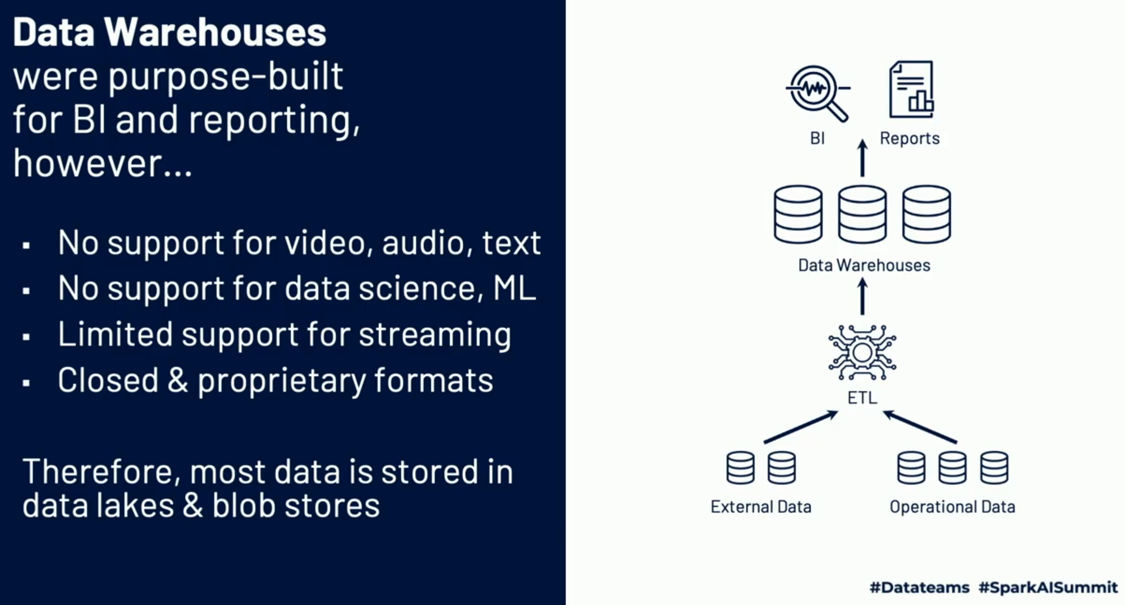

Slide 60
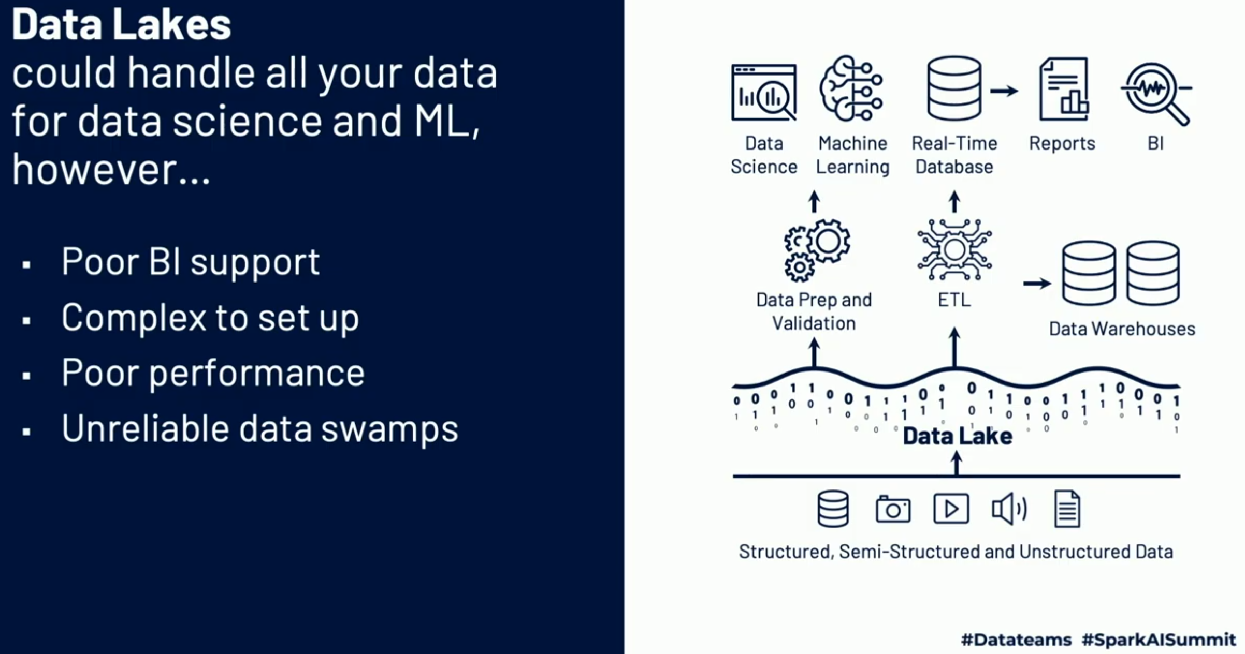
Hard to append new data (eventual consistency)
Hard to update (e.g., for GDPR/CCPA)
Missing data (e.g., due to failure)
Real-time operations + batch lead to inconsistencies
Costly to keep historical versions
Difficult to handle metadata
Too many files (millions of tiny files)
Dumping data… poor performance
Data quality (e.g., chanding semantic)
Cheap
Store all types of data
Open and standardized

Slide 61
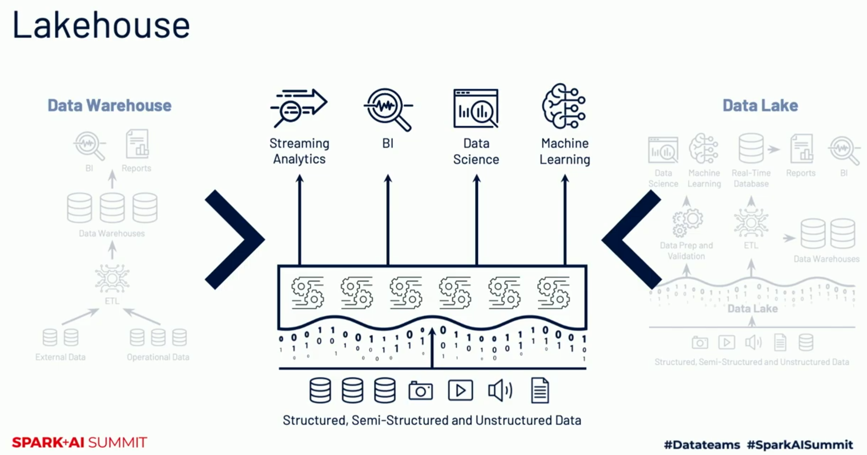
Structured transactional layer (Delta Lake)
Log (store every operation) to enable transactions (address 1 to 5 issues)
Time travel (i.e., answer queries as it was 2 years ago)
Use spark, alla metadata stored in parquet files
Index and partition data
Schema validation and evolution (start/snowflake schema)
Put in quarantine some files
Delta expectations, language to assess quality

Slide 62
Storage: file system
File system: virtual data drives that can be attached to virtual machines
AWS
Amazon’s Elastic Block Store (EBS)
Device that you can mount onto a single Amazon EC2 compute server instance at a time; it is designed for applications that require low-latency access to data from a single EC2 instance.
For example, you might use it to store working data that are to be read and written frequently by an application, but that are too large to fit in memory.
Elastic File System (EFS)
General-purpose file storage service. It provides a file system interface, file system access semantics (e.g., strong consistency, file locking), and concurrently-accessible storage for many Amazon EC2 instances. You might use EFS to hold state that is to be read and written by many concurrent processes
Google
There are three types of attached disks: persistent disk, local SSD (solid state disk), RAM disk is in-memory. Persistent disks can be accessed anywhere in a zone, but SSD and RAM are only accessible by the instance to which they are attached.

Slide 63
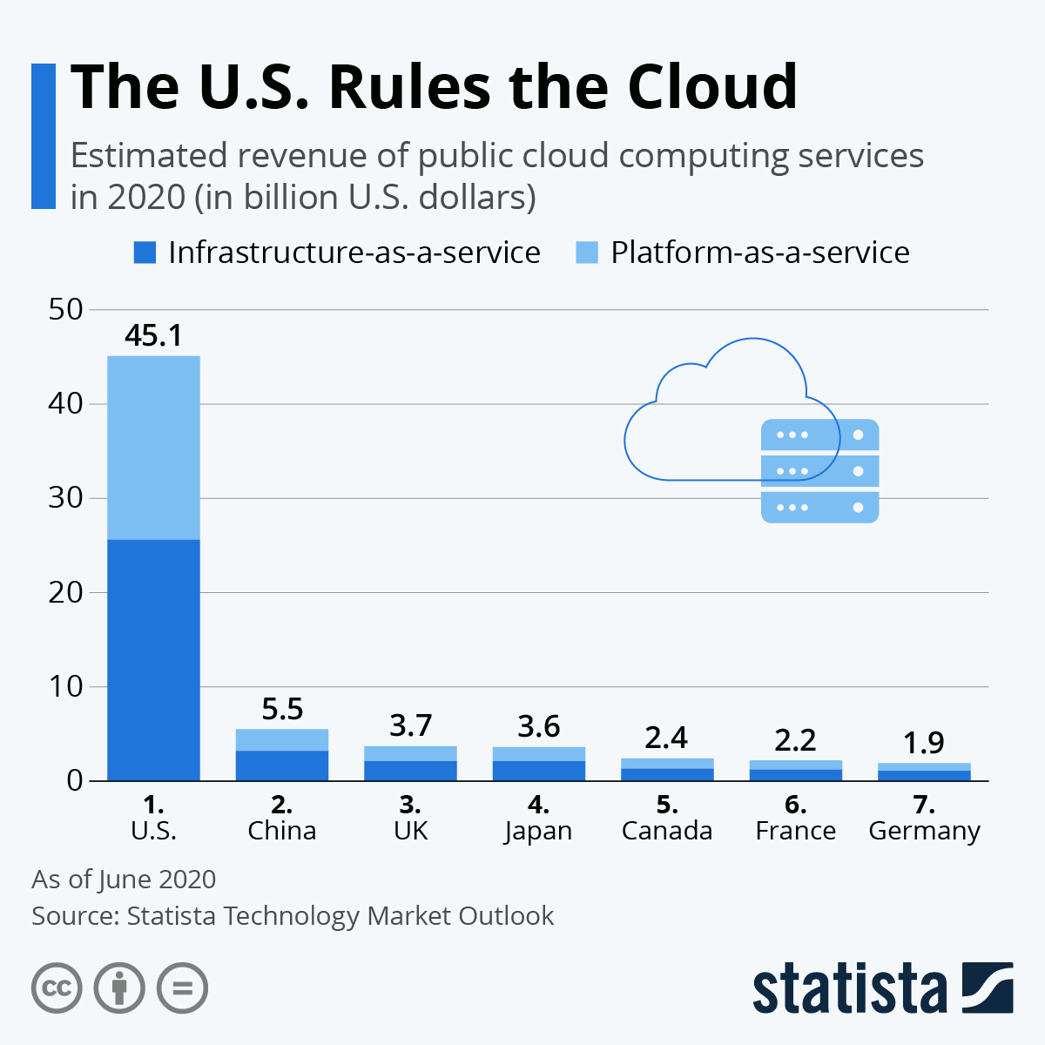
https://www.statista.com/chart/22253/estimated-revenue-public-cloud-computing-top-markets/

Slide 64
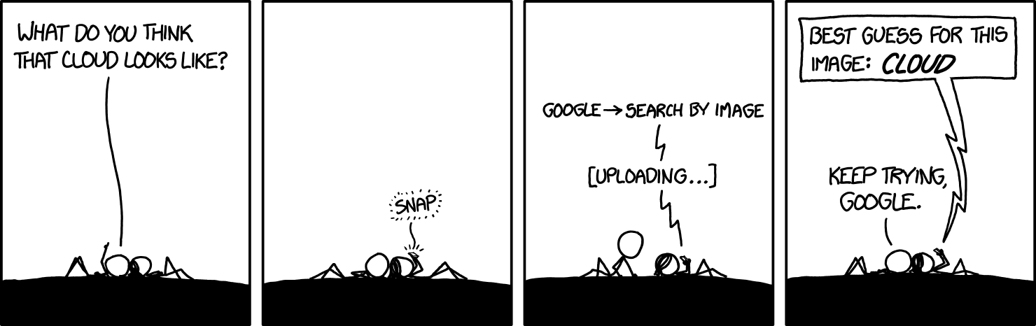

Slide 65
Data pipeline

Slide 66
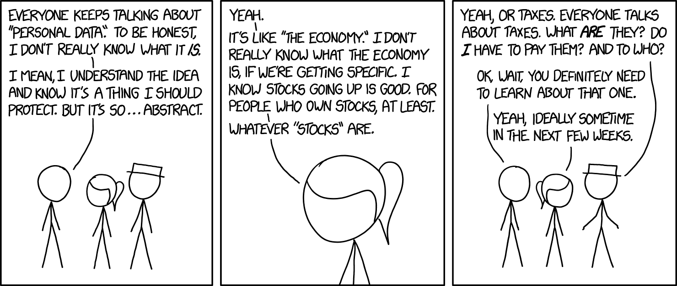
Personal data

Slide 67
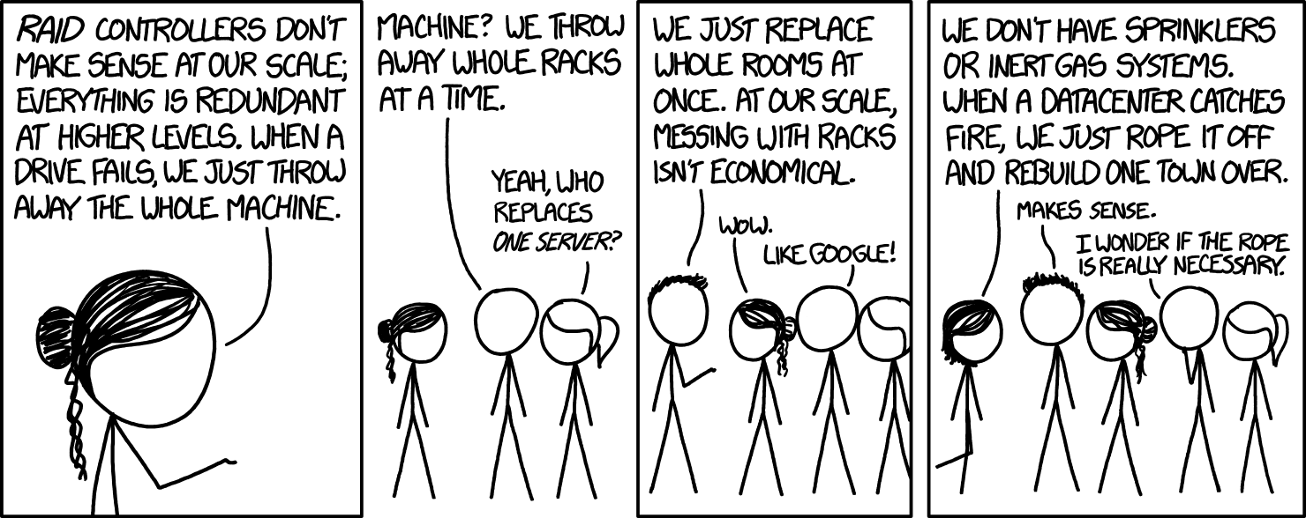
Data center

Slide 68
Cloud

Slide 69

Machine learning

Slide 70
Link utili
https://www.systutorials.com/colossus-successor-to-google-file-system-gfs/
https://cloud.google.com/files/storage_architecture_and_challenges.pdf
https://usefulstuff.io/2013/05/google-and-evolution-of-big-data/
https://googleblog.blogspot.com/2010/06/our-new-search-index-caffeine.html
https://research.google/pubs/

Slide 71
The reason behind cloud
But why is this model so compelling nowadays? To understand why, we need to look at some history. The first wave of the trend that brought us towards cloud computing was colocation, which IT shops have been doing for decades. Instead of building costly capital intensive data centers, they can rent space in shared facilities. That frees up capital for more flexible uses than real estate. In the first decade of the 2000s, IT departments' need for efficiency drove them to use virtualization. The components of a virtualized data center match the parts of a physical data center; servers, disks and so on. But now there are virtual devices separately manageable from the underlying hardware. Virtualization lets us all use resources more efficiently and just like colocation, it lets us be more flexible too. With virtualization you still buy, house and maintain the infrastructure. So, you're still in the business of guessing how much hardware you'll need and when, setting it up and keeping it running. About 10 years ago, Google realized that its business couldn't move fast enough within the confines of the virtualization model. So, Google switched to a container based architecture, an automated elastic Third Wave cloud built from automated services. We'll explain exactly what containers are later in this course. In Google's internal cloud, services automatically provision and configure the infrastructure that is used to run familiar Google applications. Google has spent billions of dollars building this platform and making it resilient and efficient. Today, Google Cloud platform makes it available to Google customers.
Benefits of AWS Security•Keep Your Data Safe:The AWS infrastructure puts strong safeguards in place to help protect your privacy. All data is stored in highly secure AWS data centers.•Meet Compliance Requirements:AWS manages dozens of compliance programs in its infrastructure. This means that segments of your compliance have already been completed.•Save Money:Cut costs by using AWS data centers. Maintain the highest standard of security without having to manage your own facility•Scale Quickly: Security scales with your AWS Cloud usage. No matter the size of your business, the AWS infrastructure is designed to keep your data safe.

Slide 72
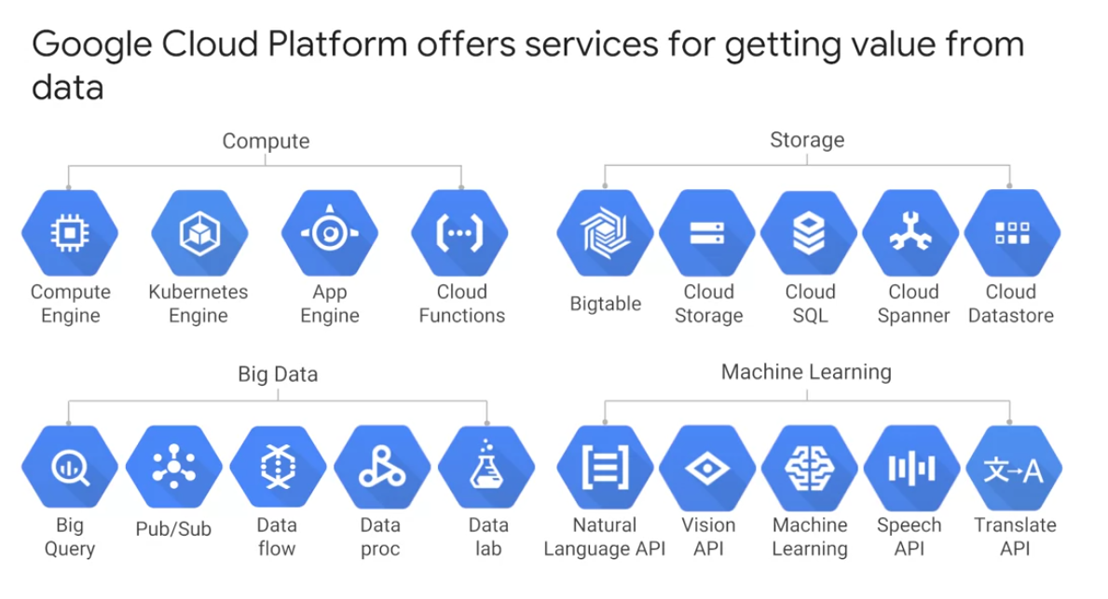

Slide 73
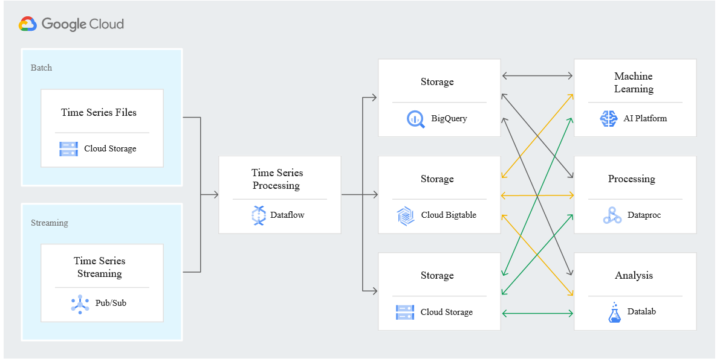
https://cloud.google.com/bigtable/

Slide 74
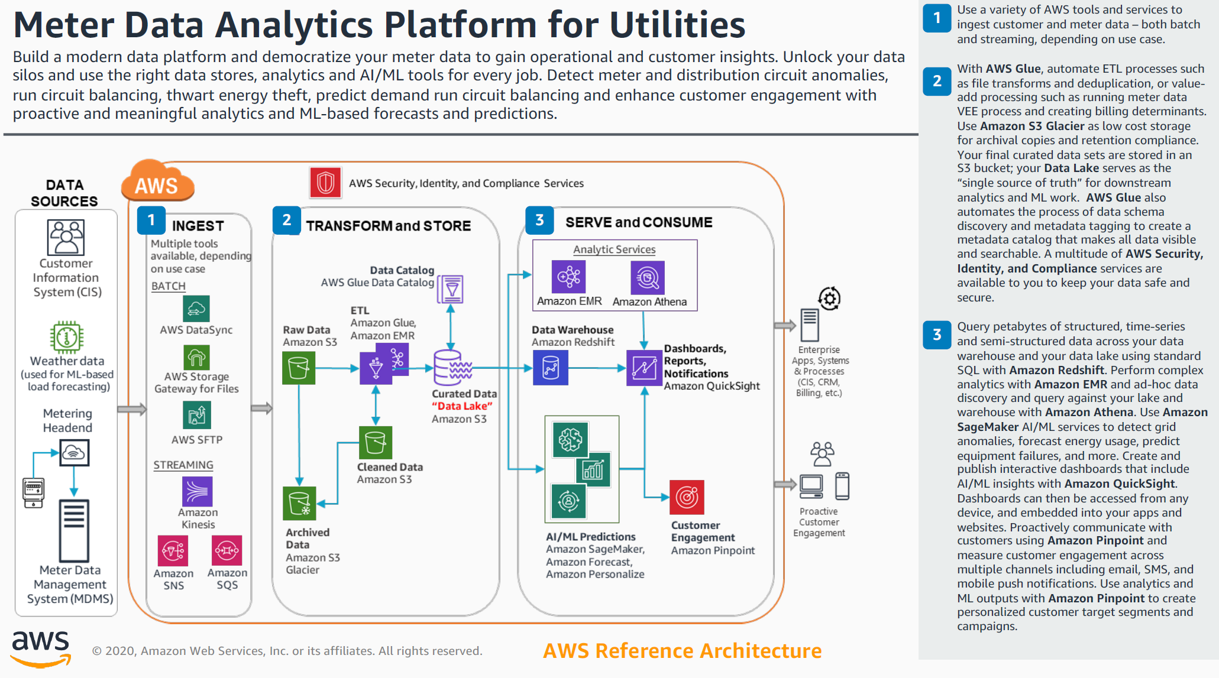

Slide 75
Google cloud platform
Some people are afraid to bring their workloads to the cloud because they're afraid they'll get locked into a particular vendor. But in lots of ways, Google gives customers the ability to run their applications elsewhere, if Google becomes no longer the best provider for their needs. Here are some examples of how Google helps its customers avoid feeling locked in. GCP services are compatible with open source products. For example, take Cloud Bigtable, a database we'll discuss later. Bigtable uses the interface of the open source database Apache HBase, which gives customers the benefit of code portability. Another example, Cloud Dataproc offers the open source big data environment Hadoop, as a managed service. Google publishes key elements of technology using open source licenses to create ecosystems that provide customers with options other than Google. For example, TensorFlow, an open source software library for machine learning developed inside Google, is at the heart of a strong open source ecosystem. Many GCP technologies provide interoperability. Kubernetes gives customers the ability to mix and match microservices running across different clouds, and Google Stackdriver lets customers monitor workload across multiple cloud providers.

Slide 76
Networking
According to some estimates out there publicly, Google's network carries as much as 40 percent of the world's Internet traffic every day. Google's network is the largest of its kind on earth and the company has invested billions of dollars over the years to build it. It's designed to give its users the highest possible throughput and the lowest possible latencies for their applications. The network interconnects at more than 90 Internet exchanges and more than 100 points of presence worldwide. When an Internet user sends traffic to a Google resource, Google responds to the user's request from an edge network location that will provide the lowest latency. Google's Edge-caching network sites content close to end users to minimize latency.
Here's how GCP is organized. Let's start at the finest grain level, the Zone, shown here on the right. A zone is a deployment area for Google Cloud Platform Resources. For example, when you launch a virtual machine in GCP using Compute Engine, which we'll discuss later, it runs in a zone you specify. Although people think of a zone as being like a GCP Data Center, that's not strictly accurate because a zone doesn't always correspond to a single physical building. You can still visualize the zone that way, though. Zones are grouped into regions, independent geographic areas, and you can choose what regions your GCP resources are in. All the zones within a region have fast network connectivity among them. Locations within regions usually have round trip network latencies of under five milliseconds. Think of a zone as a single failure domain within a region. As part of building a fault tolerant application, you can spread their resources across multiple zones in a region. That helps protect against unexpected failures. You can run resources in different regions too. Lots of GCP customers do that, both to bring their applications closer to users around the world, and also to protect against the loss of an entire region, say, due to a natural disaster. A few Google Cloud Platform Services support placing resources in what we call a Multi-Region. For example, Google Cloud Storage, which we'll discuss later, lets you place data within the Europe Multi-Region. That means, it's stored redundantly in at least two geographic locations, separated by at least 160 kilometers within Europe. As of the time of this video's production, GCP had 15 regions. Visit cloud.google.com to see what the total is up to today.
The virtual world is built on physical infrastructure, and all those racks of humming servers use vast amounts of energy. Together, all existing data centers use roughly two percent of the world's electricity, so Google works to make data centers run as efficiently as possible. Google's data centers were the first to achieve ISO 14001 certification, which is a standard that maps out a framework for improving resource efficiency and reducing waste. This is Google's data center in Hamina, Finland, one of the most advanced and efficient data centers in the Google fleet. Its cooling system uses seawater from the bay of Finland to reduce energy use. It's the first of its kind anywhere in the world. Google is one of the world's largest corporate purchasers of wind and solar energy. Google has been a hundred percent carbon neutral since 2007, and will shortly reach a hundred percent renewable energy sources for its data centers. Just like its customers, Google is trying to do the right things for the planet. GCP customers have environmental goals of their own, and running their workloads in GCP can be a part of meeting them.

Slide 77
Compute engine
Compute Engine lets you create and run virtual machines on Google infrastructure. There are no upfront investments and you can run thousands of virtual CPUs on a system that is designed to be fast and to offer consistent performance. You can create a virtual machine instance by using the Google Cloud Platform console or the GCloud command line tool. Your VM can run Linux and Windows Server images provided by Google or customized versions of these images, and you can even import images for many of your physical servers. When you create a VM, pick a machine type which determines how much memory and how many virtual CPUs it has. These types range from very small to very large indeed. If you can't find a predefined type that meets your needs perfectly, you can make a custom VM. Speaking of processing power, if you have workloads like machine learning and data processing that can take advantage of GPUs, many GCP zones have GPU's available for you. Just like physical computers need disks, so do VM. You can choose two kinds of persistent storage; standard or SSD. If your application needs high-performance scratch space, you can attach a local SSD, but be sure to store data of permanent value somewhere else because local SSDs content doesn't last past when the VM terminates. That's why the other kinds are called persistent disks. Anyway, most people start off with standard persistent disks and that's the default. You'll also choose a boot image. GCP offers lots of versions of Linux and Windows ready to go and you can import your own images too. Lots of GCP customers want their VMs to always come up with certain configurations like installing software packages on first boot. It's very common to pass GCP VM startup scripts that do just that. You can also pass in other kinds of metadata too. Once your VMs are running, it's easy to take a durable snapshot of their disks. You can keep these as backups or use them when you need to migrate a VM to another region. Suppose you have a workload that no human being is sitting around waiting to finish, say a batch job analyzing large dataset, you can save money by choosing preemptible VMs to run the job. A preemptible VM is different from an ordinary Compute Engine VM in only one respect. You've given compute engine permission to terminate it if it's resources are needed elsewhere. You can save a lot of money with preemptible VMs, although be sure to make your job able to be stopped and restarted. You can choose the machine properties of your instances such as the number of virtual CPUs and the amount of memory by using a set of predefined machine types or by creating your own custom machine types. I mentioned a bit ago that you can make very large VMs in compute engine. At the time this video was produced, the maximum number of virtual CPUs and the VM was 96 and the maximum memory size was in beta at 624 gigabytes. Check the GCP website to see where these maximums are today. These huge VMs are great for workloads like in-memory databases and CPU intensive analytics, but most GCP customers start off with scaling out not scaling up. Compute Engine has a feature called auto scaling that lets you add and take away VMs from your application based on load metrics. The other part of making that work is balancing the incoming traffic across the VMs, and Google VPC supports several different kinds of load balancing. We'll consider those in the next section.

Slide 78
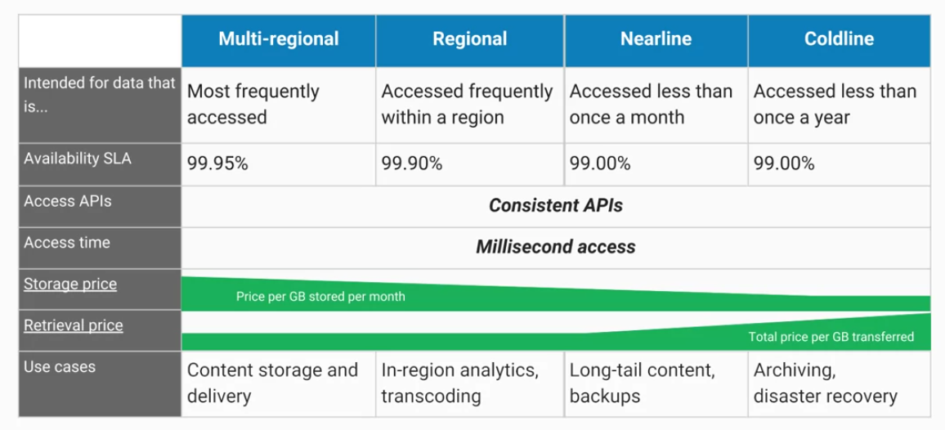
Cloud storage
Let's start with Google Cloud Storage. What's object storage? It's not the same as file storage, in which you manage your data as a hierarchy of folders. It's not the same as block storage, in which your operating system manages your data as chunks of disk. Instead, object storage means you save to your storage here, you keep this arbitrary bunch of bytes I give you and the storage lets you address it with a unique key. That's it. Often these unique keys are in the form of URLs which means object storage interacts nicely with Web technologies. Cloud Storage works just like that, except better. It's a fully managed scalable service. That means that you don't need to provision capacity ahead of time. Just make objects and the service stores them with high durability and high availability. You can use Cloud Storage for lots of things: serving website content, storing data for archival and disaster recovery, or distributing large data objects to your end users via Direct Download. Cloud Storage is not a file system because each of your objects in Cloud Storage has a URL. Each feels like a file in a lot of ways and that's okay to use the word "file" informally to describe your objects, but still it's not a file system. You would not use Cloud Storage as the root file system of your Linux box. Instead, Cloud Storage is comprised of buckets you create and configure and use to hold your storage objects. The storage objects are immutable, which means that you do not edit them in place but instead you create new versions. Cloud Storage always encrypts your data on the server side before it is written to disk and you don't pay extra for that. Also by default, data in-transit is encrypted using HTTPS. Speaking of transferring data, there are services you can use to get large amounts of data into Cloud Storage conveniently. We'll discuss them later in this module. Once they are in Cloud Storage, you can move them onwards to other GCP storage services. Just as I discussed, your Cloud Storage files are organized into buckets. When you create a bucket, you give it a globally unique name. You specify a geographic location where the bucket and its contents are stored and you choose a default storage class. Pick a location that minimizes latency for your users. In other words, if most of your users are in Europe, you probably want to pick a European location. Speaking of your users, there are several ways to control access to your objects and buckets. For most purposes, Cloud IAM is sufficient. Roles are inherited from project to bucket to object. If you need finer control, you can create access control lists - ACLs - that offer finer control. ACLs define who has access to your buckets and objects as well as what level of access they have. Each ACL consists of two pieces of information, a scope which defines who can perform the specified actions, for example, a specific user or group of users and a permission which defines what actions can be performed. For example, read or write. Remember I mentioned that Cloud Storage objects are immutable. You can turn on object versioning on your buckets if you want. If you do, Cloud Storage keeps a history of modifications. That is, it overrides or deletes all of the objects in the bucket. You can list the archived versions of an object, restore an object to an older state or permanently delete a version as needed. If you don't turn on object versioning, new always overrides old. What if versioning sounds good to you but you're worried about junk accumulating? Cloud Storage also offers lifecycle management policies. For example, you could tell Cloud Storage to delete objects older than 365 days. Or you could tell it to delete objects created before January 1, 2013 or keep only the three most recent versions of each object in a bucket that has versioning enabled.
Cloud Storage lets you choose among four different types of storage classes: Regional, Multi-regional, Nearline, and Coldline. Here's how to think about them. Multi-regional and Regional are high-performance object storage, whereas Nearline and Coldline are backup and archival storage. That's why I placed that heavy dividing line between these two groups. All of the storage classes are accessed in comparable ways using the cloud storage API and they all offer millisecond access times. Now, let's talk about how they differ. Regional storage lets you store your data in a specific GCP region: US Central one, Europe West one or Asia East one. It's cheaper than Multi-regional storage but it offers less redundancy. Multi-regional storage on the other hand, cost a bit more but it's Geo-redundant. That means you pick a broad geographical location like the United States, the European Union, or Asia and cloud storage stores your data in at least two geographic locations separated by at least 160 kilometers. Multi-regional storage is appropriate for storing frequently accessed data. For example, website content, interactive workloads, or data that's part of mobile and gaming applications. People use regional storage on the other hand, to store data close to their Compute Engine, virtual machines, or their Kubernetes engine clusters. That gives better performance for data-intensive computations. Nearline storage is a low-cost, highly durable service for storing infrequently accessed data. The storage class is a better choice than Multi-regional storage or Regional storage in scenarios where you plan to read or modify your data once a month or less on average. For example, if you want to continuously add files to cloud storage and plan to access those files once a month for analysis, Nearline storage is a great choice. Coldline storage is a very low cost, highly durable service for data archiving, online backup, and disaster recovery. Coldline storage is the best choice for data that you plan to access -at most - once a year. This is due to its slightly lower availability, 90-day minimum storage duration, costs for data access, and higher per operation costs. For example, if you want to archive data or have access to it in case of a disaster recovery event. Availability of these storage classes varies with Multi-regional having the highest availability of 99.95 percent followed by Regional with 99.9 percent and Nearline and Coldline with 99 percent. As for pricing, all storage classes incur a cost per gigabyte of data stored per month, with Multi-regional having the highest storage price and Coldline the lowest storage price. Egress and data transfer charges may also apply. In addition to those charges, Nearline storage also incurs an access fee per gigabyte of data read and Coldline storage incurs a higher fee per gigabyte of data read. Regardless of which storage class you choose, there are several ways to bring data into cloud storage. Many customers simply use gsutil which is the cloud storage command from this cloud SDK. You can also move data in with a drag and drop in the GCP console, if you use the Google Chrome browser. But what if you have to upload terabytes or even petabytes of data? Google Cloud platform offers the online storage transfer service and the offline transfer appliance to help. The storage transfer service lets you schedule and manage batch transfers to cloud storage from another cloud provider from a different cloud storage region or from an HTTPS endpoint. The transfer appliance is a rackable, high-capacity storage server that you lease from Google Cloud. You simply connect it to your network, load it with data, and then ship it to an upload facility where the data is uploaded to cloud storage. This service enables you to securely transfer up to a petabyte of data on a single appliance. As of this recording, it's still beta and it's not available everywhere. So, check the website for details. There are other ways of getting your data into cloud storage as this storage option is tightly integrated with many of the Google cloud platform products and services. For example, you can import and export tables from and to BigQuery as well as Cloud SQL. You can also store App Engine logs, cloud data store backups, and objects used by App Engine applications like images. Cloud storage can also store instant startup scripts, Compute Engine images, and objects used by Compute Engine applications. In short, cloud storage is often the ingestion point for data being moved into the cloud and is frequently the long-term storage location for data.

Slide 79


0
0
-20
-20
-60
90
-60
90

Slide 80


